Slide 1

The great debates in i.r. theory,
Foreign policy analysis & international political economy
4th teleconference Modules 10-12
Dr Zakia Aqra
02/06/2025
This presentation is recorded!
PRESS RECORDING!

Slide 2
Discussion questions
Where do we trace realism?
Where do we trace liberalism?
How did the international system emerge?
What about morality?

Slide 3
Realism/Liberalism (1930-1950)
Traditionalism/Behaviouralism (1960)
Neorealism/Neoliberalism – Marxism (1970-1980)
Rationalism/Reflectivism (1980+)
Contestation point League of Nations
- US did not ratify participation
- Italy in Ethiopia
- Japan in Manchuria
Power play vs. cooperation
Morality
Who won?

Slide 4
Who said it and when?
‘‘the complete realist, unconditionally accepting the causal sequence of events, deprives himself of the possibility of changing reality. The complete utopian, by rejecting the causal sequence, deprives himself of the possibility of understanding either the reality which he is seeking to change or the process by which it can be changed’’ (1939, p. 12).

Slide 5
Between and within the school of thought
- Methodological debate: what is the best “science” for IR?
Qualitative vs historians!
Behav. (naturalist science method)
VS
Traditionalists (or Classicists) interpretive historical methods e.g., (Hedley Bull and Carr)
The nuance was “empirical testing, mainly via falsification” e.g., (Schelling and Kaplan)
Realism/Liberalism (1930-1950)
Traditionalism/Behaviouralism (1960)
Neorealism/Neoliberalism – Marxism (1970-1980)
Rationalism/Reflectivism (1980+)

Slide 6
NEO-NEO debate (inter-paradigm)
- Kenneth Waltz 1979 reboot Realism (from human nature to a Structural Realism associated with the international system (behavioralist)
- Robert Keohane and Joseph Nye → effects transnational relations on the interstate system (national sovereignty, foreign policies, IO)
- Convergence between neolib. & neoreal.
The former accepted state egoism and the latter interrelated entities.
Realism/Liberalism (1930-1950)
Traditionalism/Behaviouralism (1960)
Neorealism/Neoliberalism – Marxism (1970-1980)
Rationalism/Reflectivism (1980+)

Slide 7
A Epsitimological Debate!
Rationalists (Realist and Liberalist) → positivistic methodology.
Reflectivists reject these positivist methods of knowledge generation, preferring interpretive and subjective study and a belief that values cannot be separate from observation.
post-modernism (link between the status quo and the knowledge it generates)
Feminism (lens of women)
Constructivism (social theory and ideas)
Critical theory (Marxist spinoff)
Too much of a deconstruction? What about construction?
Is it stagnant? Enriched methodology?
Realism/Liberalism (1930-1950)
Traditionalism/Behaviouralism (1960)
Neorealism/Neoliberalism – Marxism (1970-1980)
Rationalism/Reflectivism (1980+)

Slide 8
What is Foreign policy as a concept?
Conduct relations with other actors (state or non-state, including IGO)
Operates outside the realm of their sovereignty
Scope to influence goals and activities of others
Policymaking is an instrumental concept:
what is the problem or goal and which solutions or approaches are available to address it?

Slide 9

Foreign Policy
International
Regional
State
IR theories implications on the constraints and opportunity of the system (structure)
Foreign policy in Political Science (key policy makers/ agents)
FP in IR interplay between human agents and structures (Structure/agency nexus)
circumstances of uncertainty and with imperfect knowledge

Slide 10
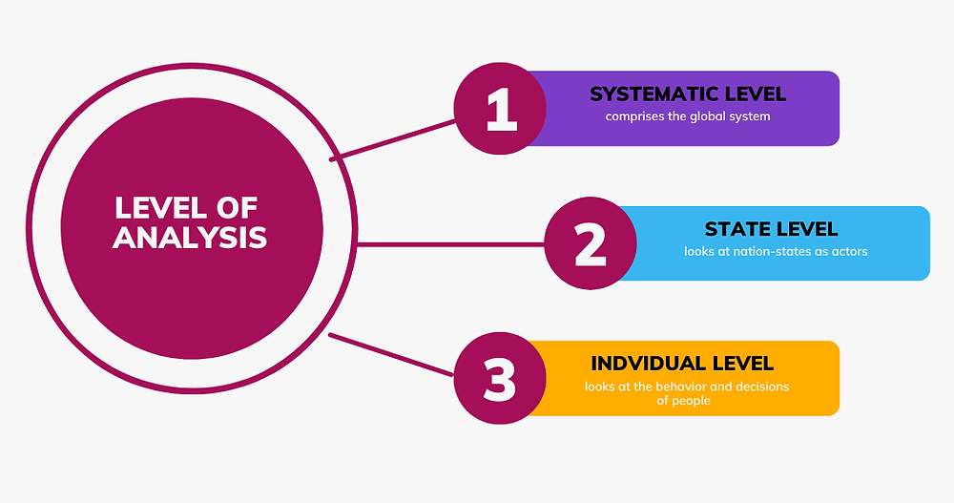

Slide 11
Foreign policy analysis
Realist scholars → value national security (military power) and balancing that of other
International Society scholars → value order and justice: a rule-based and well-ordered international society is a major goal
Liberal scholars →the value freedom and democracy (e.g. liberal democracies will support peaceful international cooperation based on international institutions
Some FPA are approaches are derived from IR theories and some are adapted from other disciplines, such as economics or social psychology.

Slide 12
Approaches to FPA
Traditional approach: focus on the decision-maker
- outcomes and consequences of past foreign policy decisions and actions
- involves an ability to recognize the circumstances under which a government must operate in carrying out its foreign policy (Machiavelli/ Kissinger/ Kennan)
2. Comparative foreign policy: behaviouralism and ‘pre-theory’
- idiosyncratic, role, governmental, societal, and systemic variables (James Rosenau’s (1966) ‘pre-theory’)

Slide 13
Approaches to FPA
3. The rational actor model (RAM)
- rational policies that maximize gains at minimum cost
4. Bureaucratic structures and processes
decision-making during crisis
focuses on the organizational context
Analyzing processes and channels is a superior way of obtaining empirical knowledge of foreign policy
Graham Allison’s book on the 1962 Cuban missile crisis, Essence of Decision (Allison 1971)
5. Cognitive processes and psychology
psychological aspects of decision making, such as perceptions of actors.

Slide 14
Approaches to FPA
6. ‘Multilevel, multidimensional’; the general theories
Many scholars now study particular aspects of foreign policymaking:
balance of power behaviour
deterrence
security dilemmas
game theory
the role of international Institutions
relationship between core and periphery
7. The constructivist turn
identities before interests
‘Strategic culture’

Slide 15
Levels of Analysis
distribution of power among states in the international
system; their political and economic interdependence)
Nation-state level
type of government, democratic/authoritarian; state/society relations state apparatus and groups in society (lobbies); the bureaucratic apparatus
Level of the individual decision maker
his/her way of thinking, basic beliefs,
personal experiences and priorities
The systemic level

Slide 16
Systemic level
Conceptualizing the International system (structure of the system)
Constrains and opportunities
key difference between the foreign policy of great and small powers
Connection between those conditions and the actual foreign policy behaviour
Notes:
How would realist approach this?
How would liberals approach this?
How would constructivists approach this?

Slide 17
Nation-State Level
Domestic factors
Relationship between state and society
(mobilization and manage resources)
Who is making the decision? President, Vice President, Bureaucracy, Lobbies?

Slide 18
The Individual Level
effects of systemic structures or domestic pressures on decision makers
literature on human cognition and belief systems
Acquiring the knowledge/intelligence
1. through the content of policymaker beliefs
2. through the organization and structure of policymaker beliefs
3. through common patterns of perception (and misperception)
4. through cognitive rigidity (and flexibility) for change and learning.

Slide 19
Gulf War case study
Why did the United States decide to go to war in the Persian Gulf?
YETIV 2011 → RAM; the groupthink model; and the cognitive model
RAM: perceived itself as having vital national interests in the Persian Gulf.
exhaust diplomatic and economic alternatives to war
due to intransigent Iraqi regime, the costs of waiting for sanctions would exceed the benefits
taking into consideration Iraq’s behaviour in the crisis NO negotiated settlement, because their bargaining positions did not overlap
4) the structural condition of anarchy in international relations

Slide 20
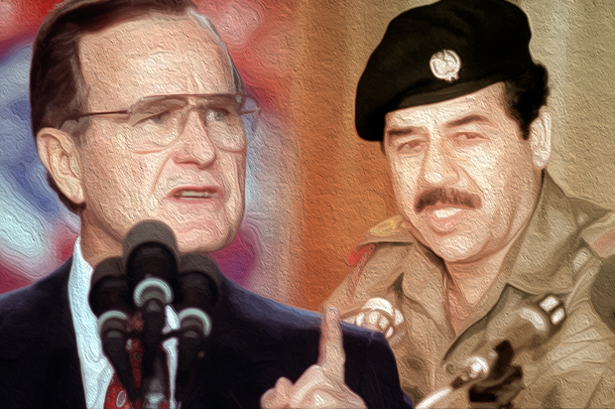
Gulf War case study
Cognitive: G. Bush Sr perception of Saddam
Bush tended to see Saddam as a Hitler-like dictator who could not be accommodated or even offered a minor, veiled carrot.
The analogy made Bush more likely to personalize the conflict with Saddam, to undermine others’ efforts at compromise with Saddam, and to prefer war to the continued use of economic sanctions.

Slide 21
Gulf War case study
Groups: war vs sanctions
Inner group of four
(President George Bush, Vice President Dan Quayle, National Security Adviser Brent Scowcroft, and Chief-of-Staff John Sununu)
VS
Outer group of eight (Secretary of State James Baker, Secretary of Defense Richard Cheney, Chairman of the Joint Chiefs-of-Staff Colin Powell, and Deputy National Security Adviser Robert Gates)

Slide 22
Donald Trump and US FP
A stand-off between Trump on the one hand and the system (international and national) on the other hand; who won?
Did he change US FP?
Style / discourse
Walt (2020) → Both Trump and Obama, then, represent a swing away from the optimistic global democracy-promotion of Bill Clinton and George W. Bush, towards a more modest view of US power and an increasing focus on the challenge from China. Similar to WW1 US approach
Trump’s foreign policy is the natural reaction of a declining hegemonic power no longer willing to invest in common purposes of the international society.
Foreign policy impacted by his domestic clashes with courts and constituency

Slide 23
International political economy
What is IPE and why is it important?
Give the core arguments made by the three main theories of IPE: mercantilism, economic liberalism, and Marxism. Which theory, if any, is the best one? Why?

Slide 24
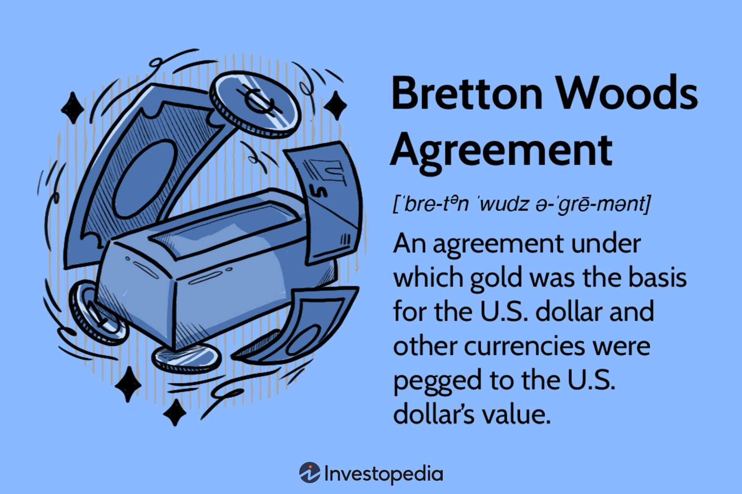
Politics and economy
Interplay between states and market
Economic relations across boarders
International political economy / global political economy
Low politics according to realists
It changed in the 1970s…
End of Bretton Wood
Oil crisis 1973
New International Economic Order?

Slide 25
3 main theories in IPE

