Slide 1

Counter-terrorism amidst concerns about human rights and democracy
BSc in International Relations & Security
Terrorism, Asymmetric Threats and International Security| 4th Teleconference (11-12)
Marina Eleftheriadou

Slide 2
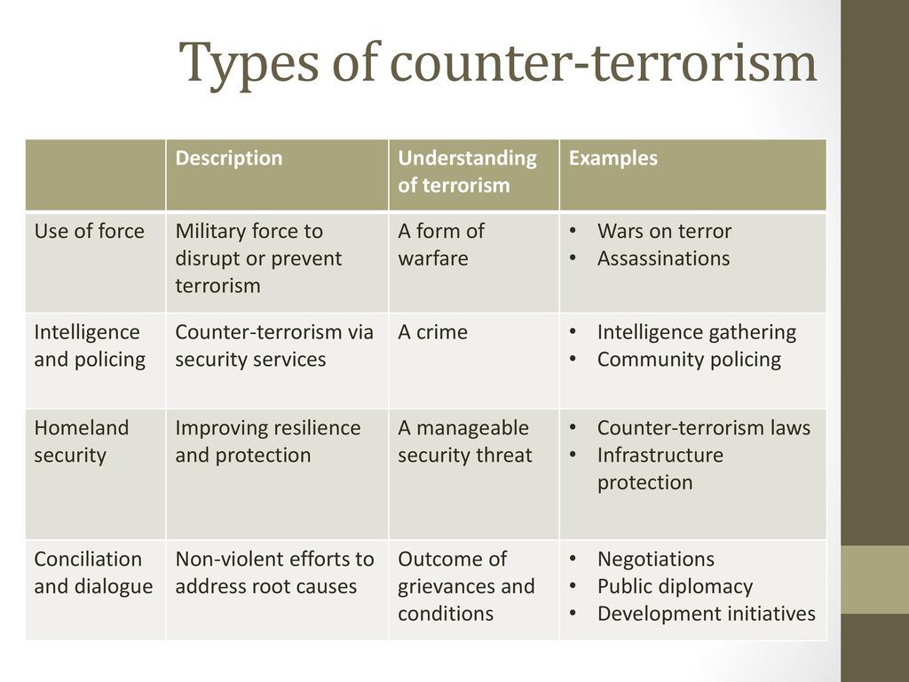
counter-terrorism

Slide 3
Types of counter-terrorism
Coercive counterterrorism
    The criminal justice model
    The war model
Proactive counterterrorism
    The intelligence model
Persuasive counterterrorism
    The communication model
Defensive counterterrorism
    Prevention (before an attack): The preventive mode
    Mitigation (response to an attack): The natural disaster model , the public health model, the psychosocial model
Long-term counterterrorism
  The development model
  The human security model

Slide 4
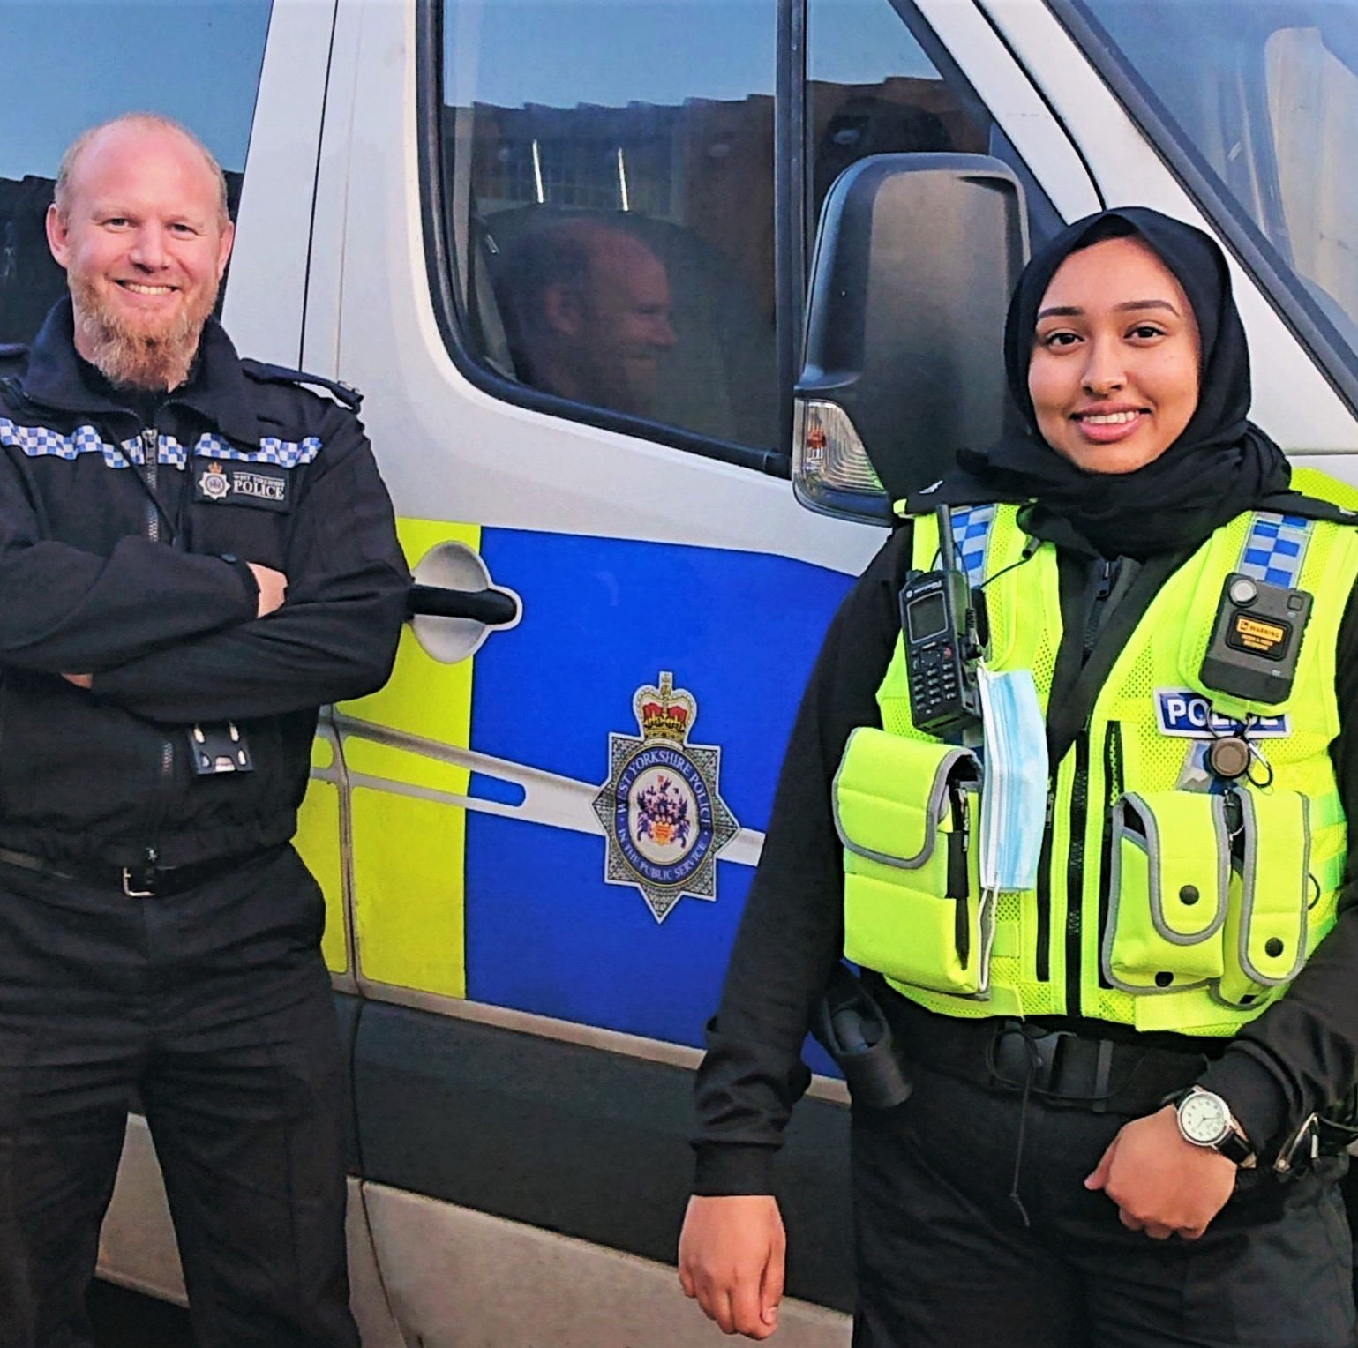
Prevention
Intelligence Gathering: Surveillance, monitoring communications, infiltrating groups.
Threat Assessment: Identifying and evaluating potential threats and actors.
Counter-Radicalization Programs: Community outreach, education to prevent recruitment and ideological indoctrination, addressing causes of radicalisation before it occurs
Resilience and protection measures: Hardening of Targets, critical infrastructure protection

Slide 5
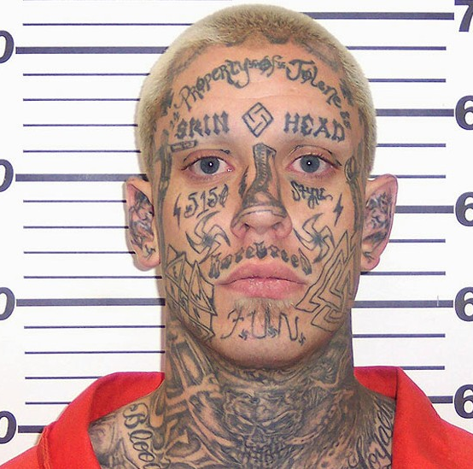
Intervention
Law Enforcement & Legal Approaches: counter-terrorism legislation, criminal investigations, financial disruption
Cyber Counter-Terrorism: monitoring of online activity, cybersecurity measures, counter-messaging

Slide 6
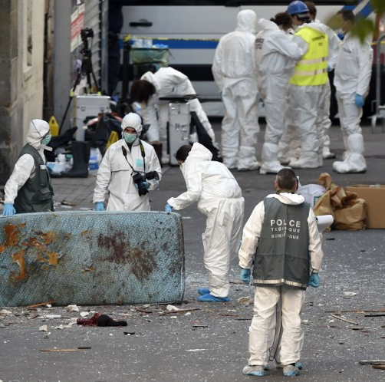
reaction
Post-attack responses: emergency response and rescue, investigation and forensics, public communication
Military and paramilitary operations: special forces operations, airstrikes and drone strikes, counterinsurgency campaigns

Slide 7
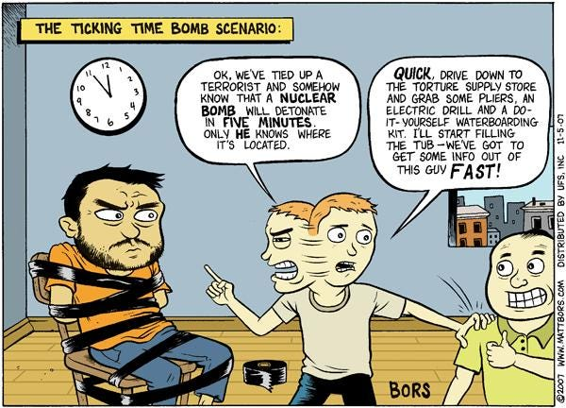
The limits of counter-terrorism
International law
Human rights
The theory of the “ticking time bomb"
State of exception
The War on Terror and American "Exceptionalism"

