Slide 1

Liberalism, other liberal theories and Marxism in IR
2nd Teleconference
Modules 4-6
Dr Zakia Aqra
11/04/2024

Slide 2
Main concepts
Peace is not the natural state of the international system
It needs to be built
states are central
International organizations limit anarchy and insecurity
Principle of asymmetric economic interdependence
opening of borders
Soft Power + Hard Power = Smart Power
The position of morality
The right to self-determination?
Joseph Nye, Robert, Keohane, Francis Fukuyama

Slide 3
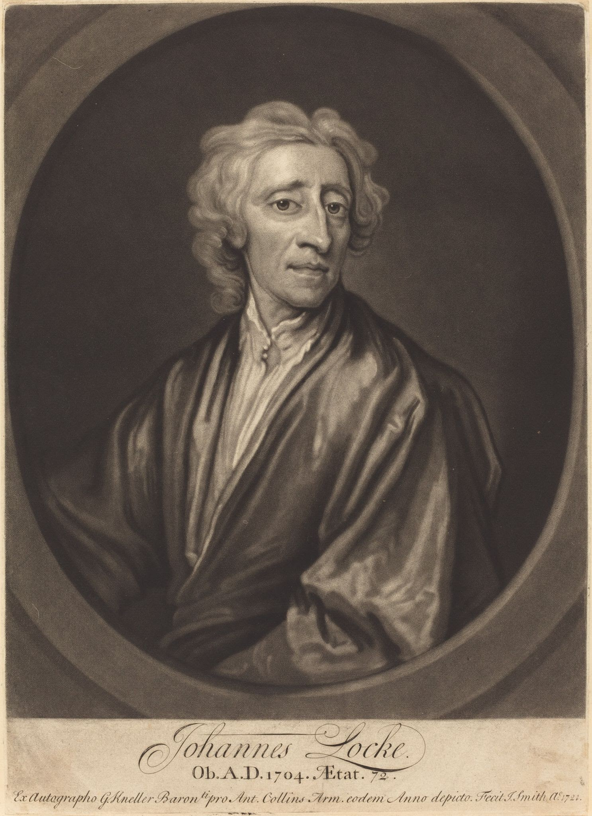
LIBERALISM
Positive view of human nature
IR can be cooperative
Believe in progress
Locke (17th century) saw great potential for human progress in modern civil society and capitalist economy.
Progress in states guarantees individual liberty
Improved technologies, efficient ways of producing goods, intellectual revolution.

Slide 4
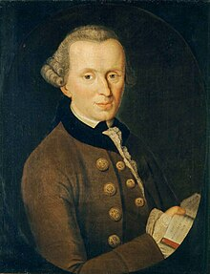
KANT | Towards a Perpetual Peace (1795)
Humanity is a global community
The transgressions concern all the peoples of the earth
Consolidation of International Law
If every state is a democracy, it is not easily approved and war is limited, the next stage is the (co)federation, permanent peace with an international treaty.
Only defensive warfare is considered acceptable
Revolutions only when they are for the progress of humanity (French, American)
Non-intervention in the internal affairs of other states (except in civil war)

Slide 5
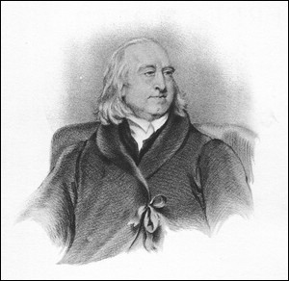
BENTHAM | Plan for a Universal and Lasting Peace (1786-9)
Coined the term ‘International’
War is an obsolete institution and serves only the interests of monarchs
Against secret diplomacy
Democratic regimes are “peace-loving”
The main causes of war → colonies
Was in favour of an international court

Slide 6
ANGELL | The great illusion (1909)
  War not a rational choice
  Interdependence theory
  Economic interdependence cannot lead to war?

Slide 7
Interdependence liberalism
People and governments are affected by what happens elsewhere.
Modernization increases the level and scope of interdependence between states.
Post war economically successful countries: trading states, economic power.
Trading states if preferred > War now occurs in less developed states.
Greater interdependence in the form of transnational ties between countries could lead to peace.

Slide 8
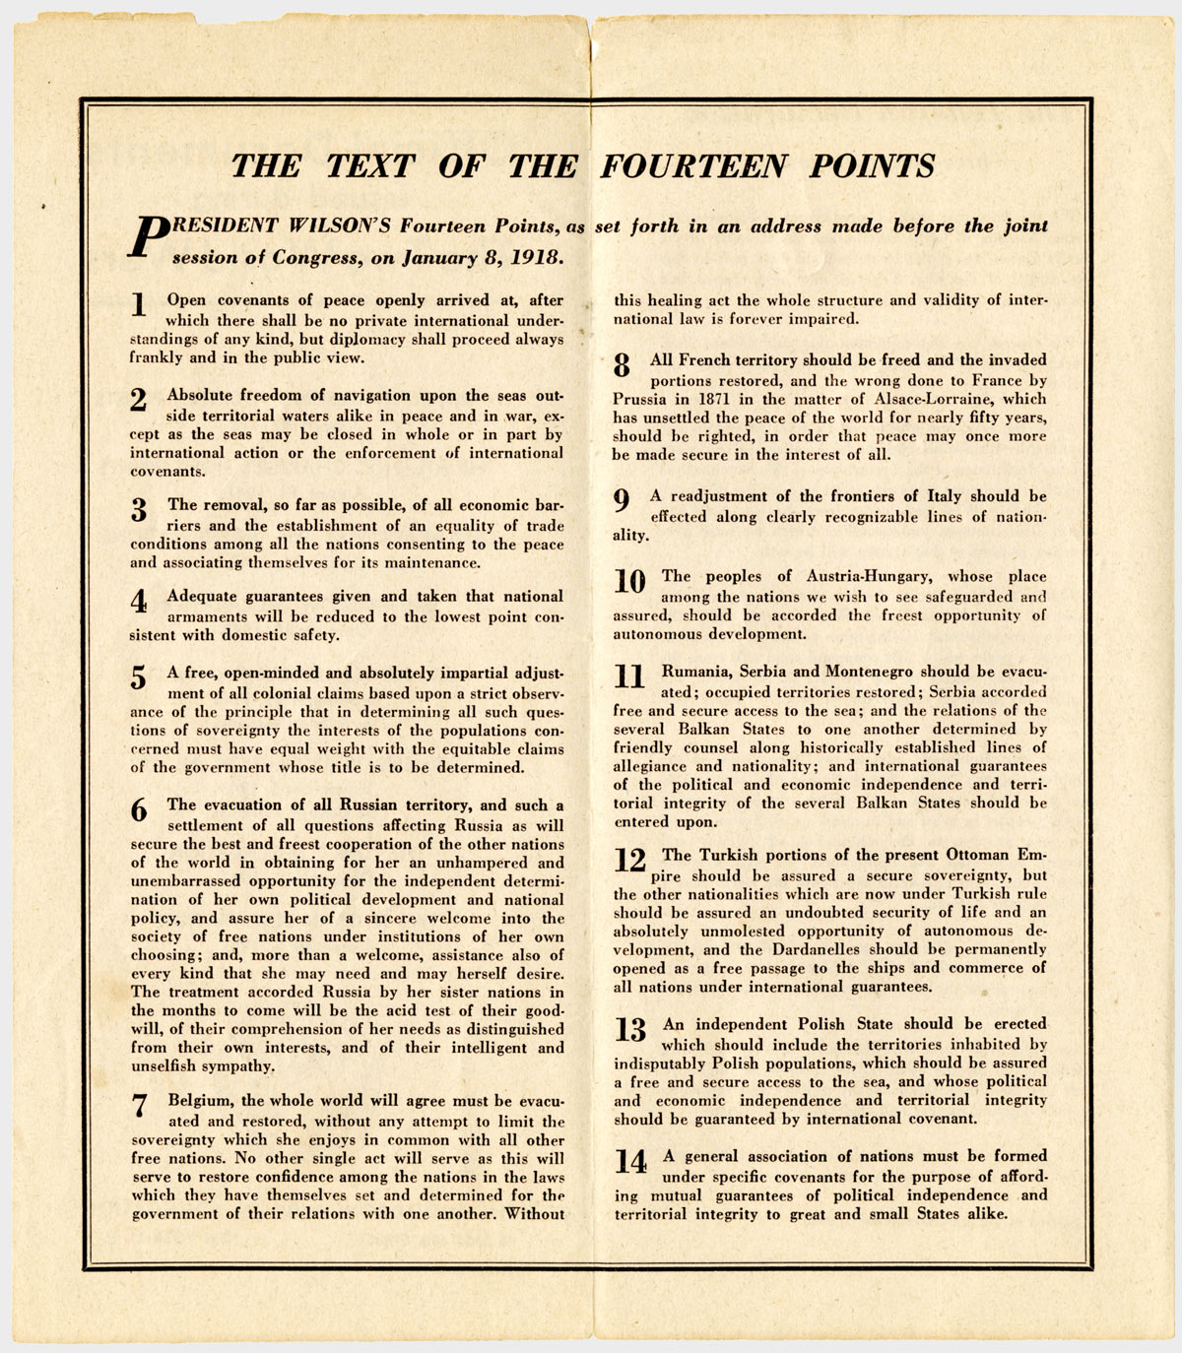
WILSON | 14 points (1918)
He set the tone for the post-war era
Emphasis on international peace and security
Inspired the League of Nations
Settlement of the colonial expansion of Europeans
Principle of self-determination
International system (from a jungle into a zoo)

Slide 9
MITRANY | The Functional Theory of Politics (1930-1950)
Functionalism: maximising prosperity through the creation of transnational links and global organisations for the benefit of all
Beyond economic links and creation of communities
War becomes unthinkable
Softens antagonism

Slide 10
Sociological liberalism
IR is not only a ‘only about state—state relations; itis also about transnational relations: i.e., relations between people, groups, and organizations belonging to different countries.
Transnational relations between people from different countries help create new forms of human society > more cooperative

Slide 11
Institutional liberalism
Beneficial effect of international institutions
Building of International Organizations
Examples: NATO, EU, WTO or sets of rules eg agreements
Depth of institutionalism: commonality, specificity, autonomy
Help promote cooperation based on trust

Slide 12
FUKUYAMA | The end of history (1989)
  Claimed that liberalism overshadows all other theories
  Liberal states are more stable internally and more peaceful in their international relations

Slide 13
Republican liberalism (Hook)
liberal democracies are more peaceful and law-abiding than are other political systems.
Democracies lead to peace because:
  existence of political culture based on peaceful conflict resolution
  common moral values
  strengthened through economic cooperation and interdependence

