Slide 1

Political, religious and ethnic terrorism
BSc in International Relations & Security
Terrorism, Asymmetric Threats and International Security| 3st Teleconference (6-10)
Marina Eleftheriadou

Slide 2
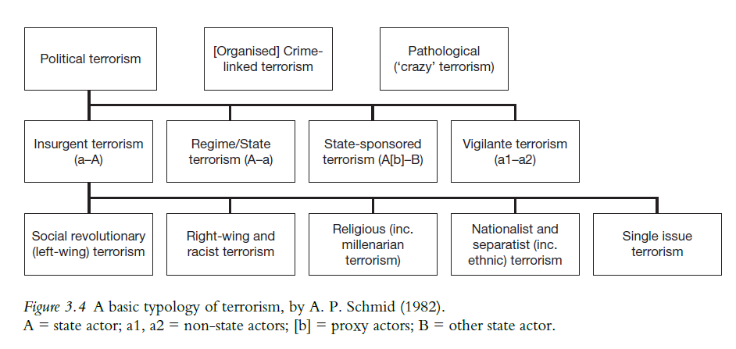
A basic typology

Slide 3

Political / ideological Terrorism
Use of violence to achieve political objectives narrowly defined
Common features:
  anti-government goals,
  ideological motivations,
  targeted violence
Fused ideologies
  Ethnic and left-wing

Slide 4
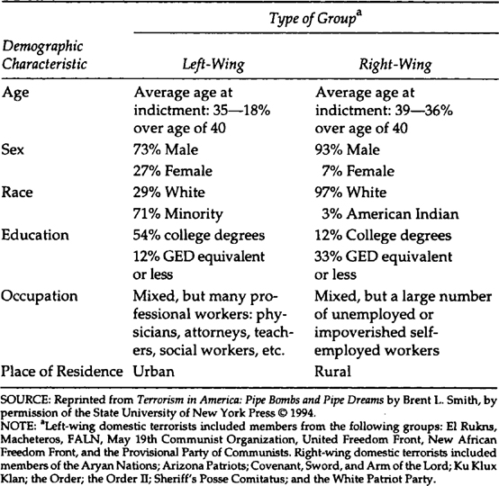

Left-wing
Strategy
  Classical guerrilla warfare (Mao Zedong and Vo Nguyen Giap)
  Foco theory (Che Guevara and Regis Debray)
  Urban guerrilla warfare (Carlos Marighella)
Tactics
  bombings,
  hijackings,
  assassinations
  kidnappings

Slide 5


right-wing
Types
  White Supremacist
  Neo-Nazi / Fascist
  Anti-Government / Sovereign Citizen / Militia Movements
  Anti-Immigrant / Nativist
  Christian Extremist
  Incel Extremist
Tactics
  Mass Shootings
  Bombings / arson
  assassinations
  Vehicle-borne
  Harassment / threats

Slide 6
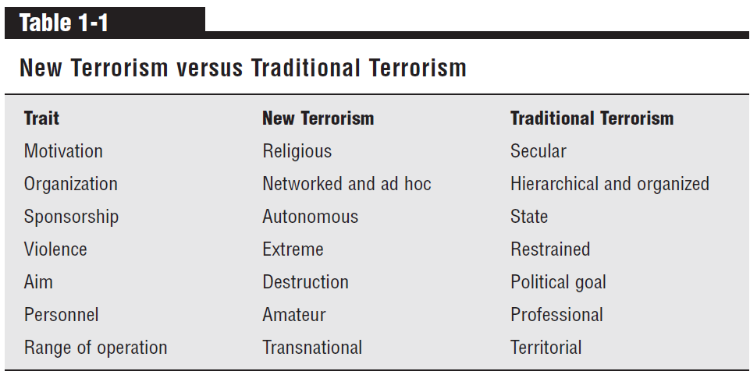
Religious terrorism
Strategy
  Provocation and Polarization
  Building of a religious utopia
Tactics
  Suicide bombings
  Mass shootings
  Beheadings and Executions
  Bombings and IEDs

Slide 7
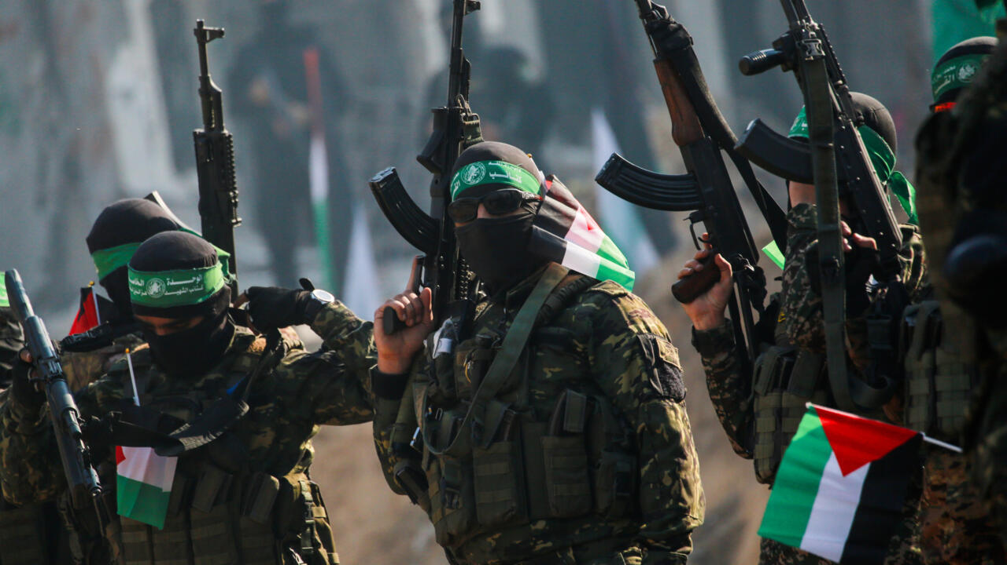
ethnic terrorism
Identity-Based Violence (Ethnic Nationalism)
Goal: establishment of an independent state
Targets: Rival Ethnic Groups / members of the in-group
The role of diasporas
Tactics
  Guerrilla-type hit-and-run
  Bombings and IEDs
  Suicide bombings
  Assassinations
  Massacres and forced displacement

Slide 8
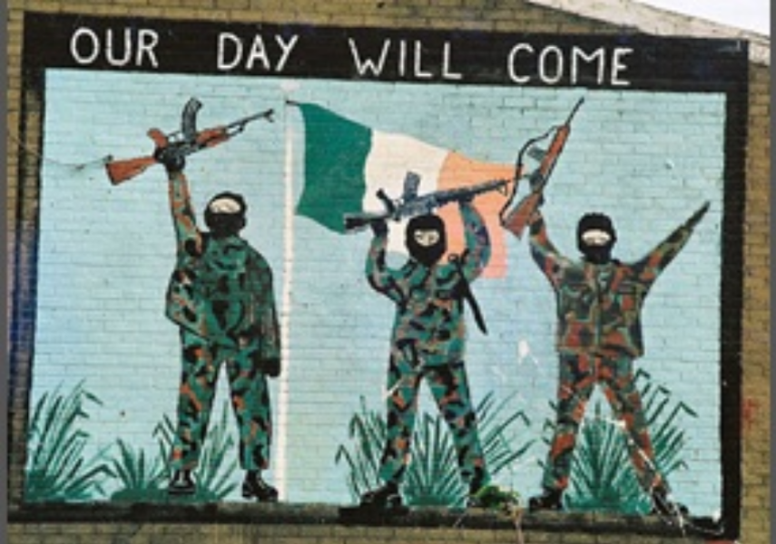
Irish Republican Army (IRA)
Old and New IRA (Official and Provisional)
Unionists (mainly Protestant) and Nationalists (mainly Catholic)
Goal: End British rule in Northern Ireland / unification with Republic of Ireland
Radicalisation: Civil rights movement (1960s)
Military and political wing (Sinn Féin) / Hierarchical structure with limited cell autonomy
Out-group and in-group targets
Tactics
  Bombings and IED’s (especially car bombs and booby traps),
  Assassinations
  Ambushes and sniper attacks
  Kidnappings
  Kneecapping

Slide 9
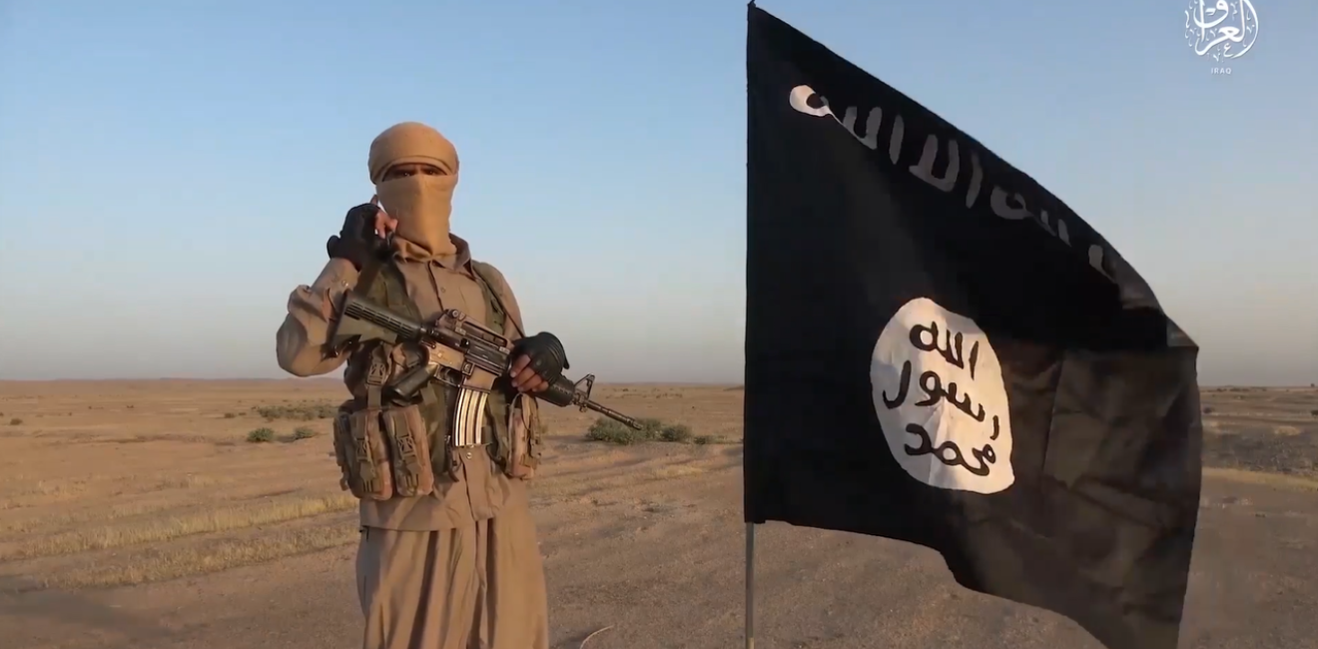
Islamic state (IS)
From Jama'at al-Tawhid wal-Jihad to ISIS and IS
Strategy:
  Three 'fields of action': Syria/Iraq/Wider Middle East/Rest of the world
  Abu Bakr Naji - The Management of Savagery: Disruption of the status quo / Violence as a catharsis and a tool / Military Consolidation/ Political consolidation/ Expansion
Building an "Islamic Utopia“
  Selective homogenization of the population
  Occupation of basic infrastructure
  Exploitation of pre-existing structures
  "Social contract": Bread – Education – Health – Safety
  Complete (and Islamically correct) regulation of all aspects of daily life
Varying tactics

