Slide 1

modus operandi and media
BSc in International Relations & Security
Terrorism, Asymmetric Threats and International Security| 2st Teleconference (4-5)
Marina Eleftheriadou

Slide 2
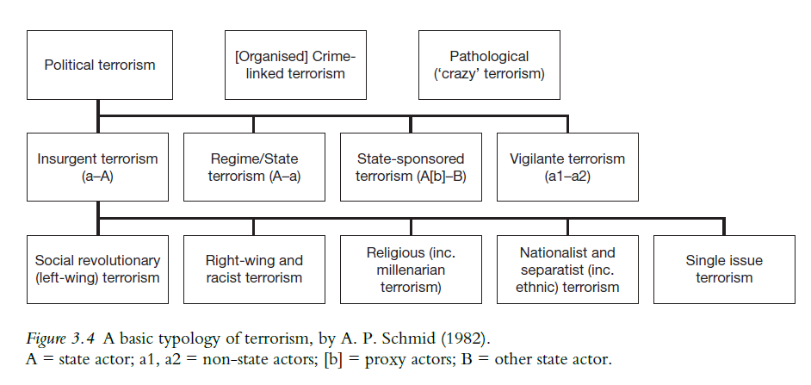
A basic typology

Slide 3
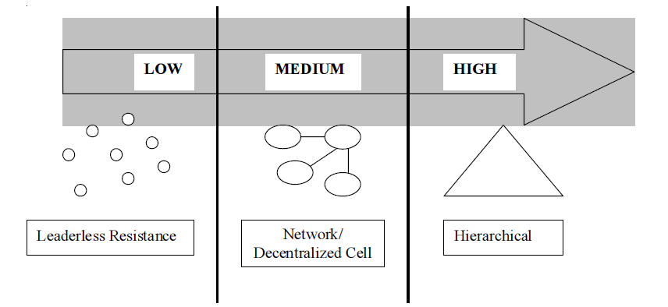
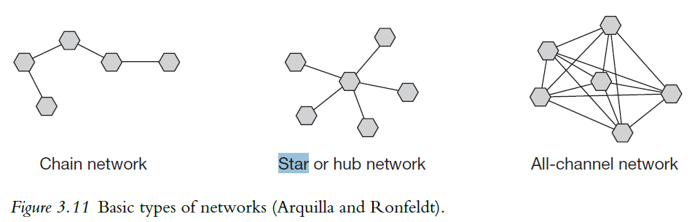
Organizational structure
Leaderless resistance
  Organizational
  Operational
  Financial
  Ideological
Hive terrorism

Slide 4
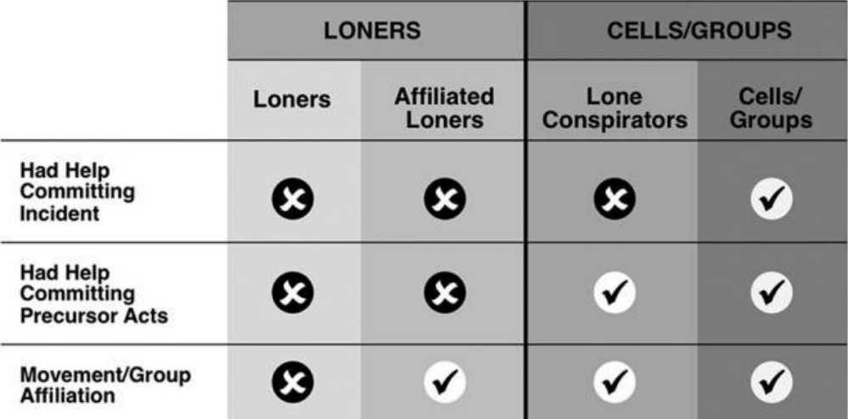
How lonely are “lone wolves”?

Slide 5
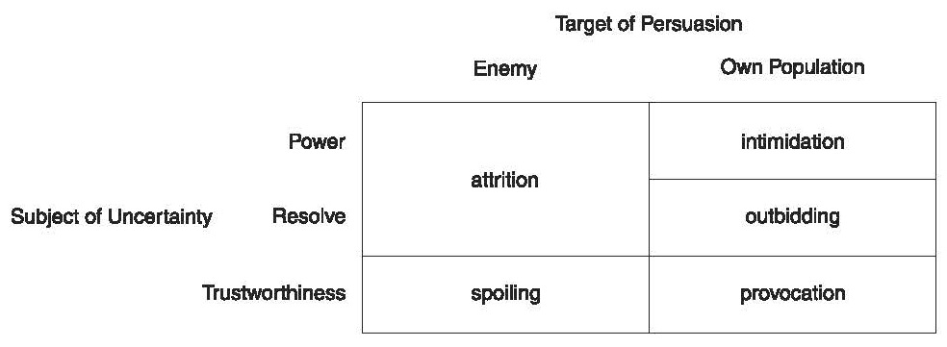
Strategies of terrorism
Making grievances and demands known
Attrition
  Importance of demands
  Possibility of retaliation
  Social resilience
Provocation
  Checks and balances
Intimidation
  State weakness
Spoiling
Outbidding)

Slide 6
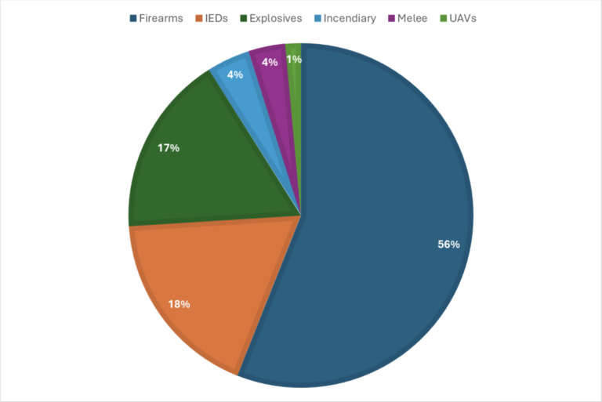
Tactics of terrorism
Bombings/explosions
Firearms/shootings
Hijackings
Hostage-taking
Suicide atatcks
Vehicle-borne attacks
CBRN atatcks
Blunt objects/stabbing
Melee
Most Common Weapon Types in Terrorist Attacks (2018-2023)

Slide 7
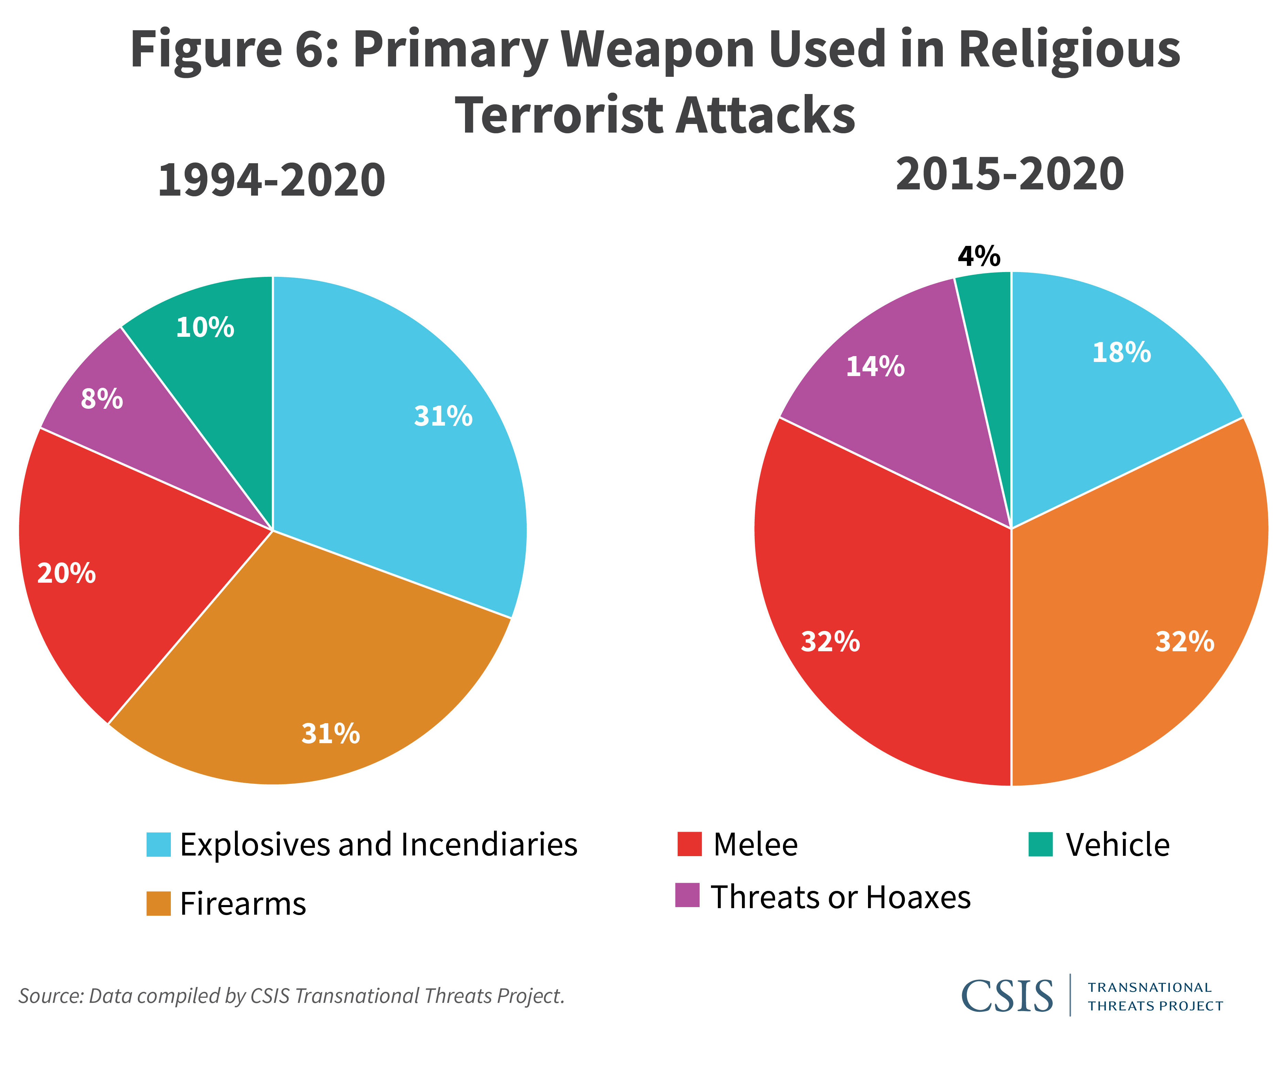
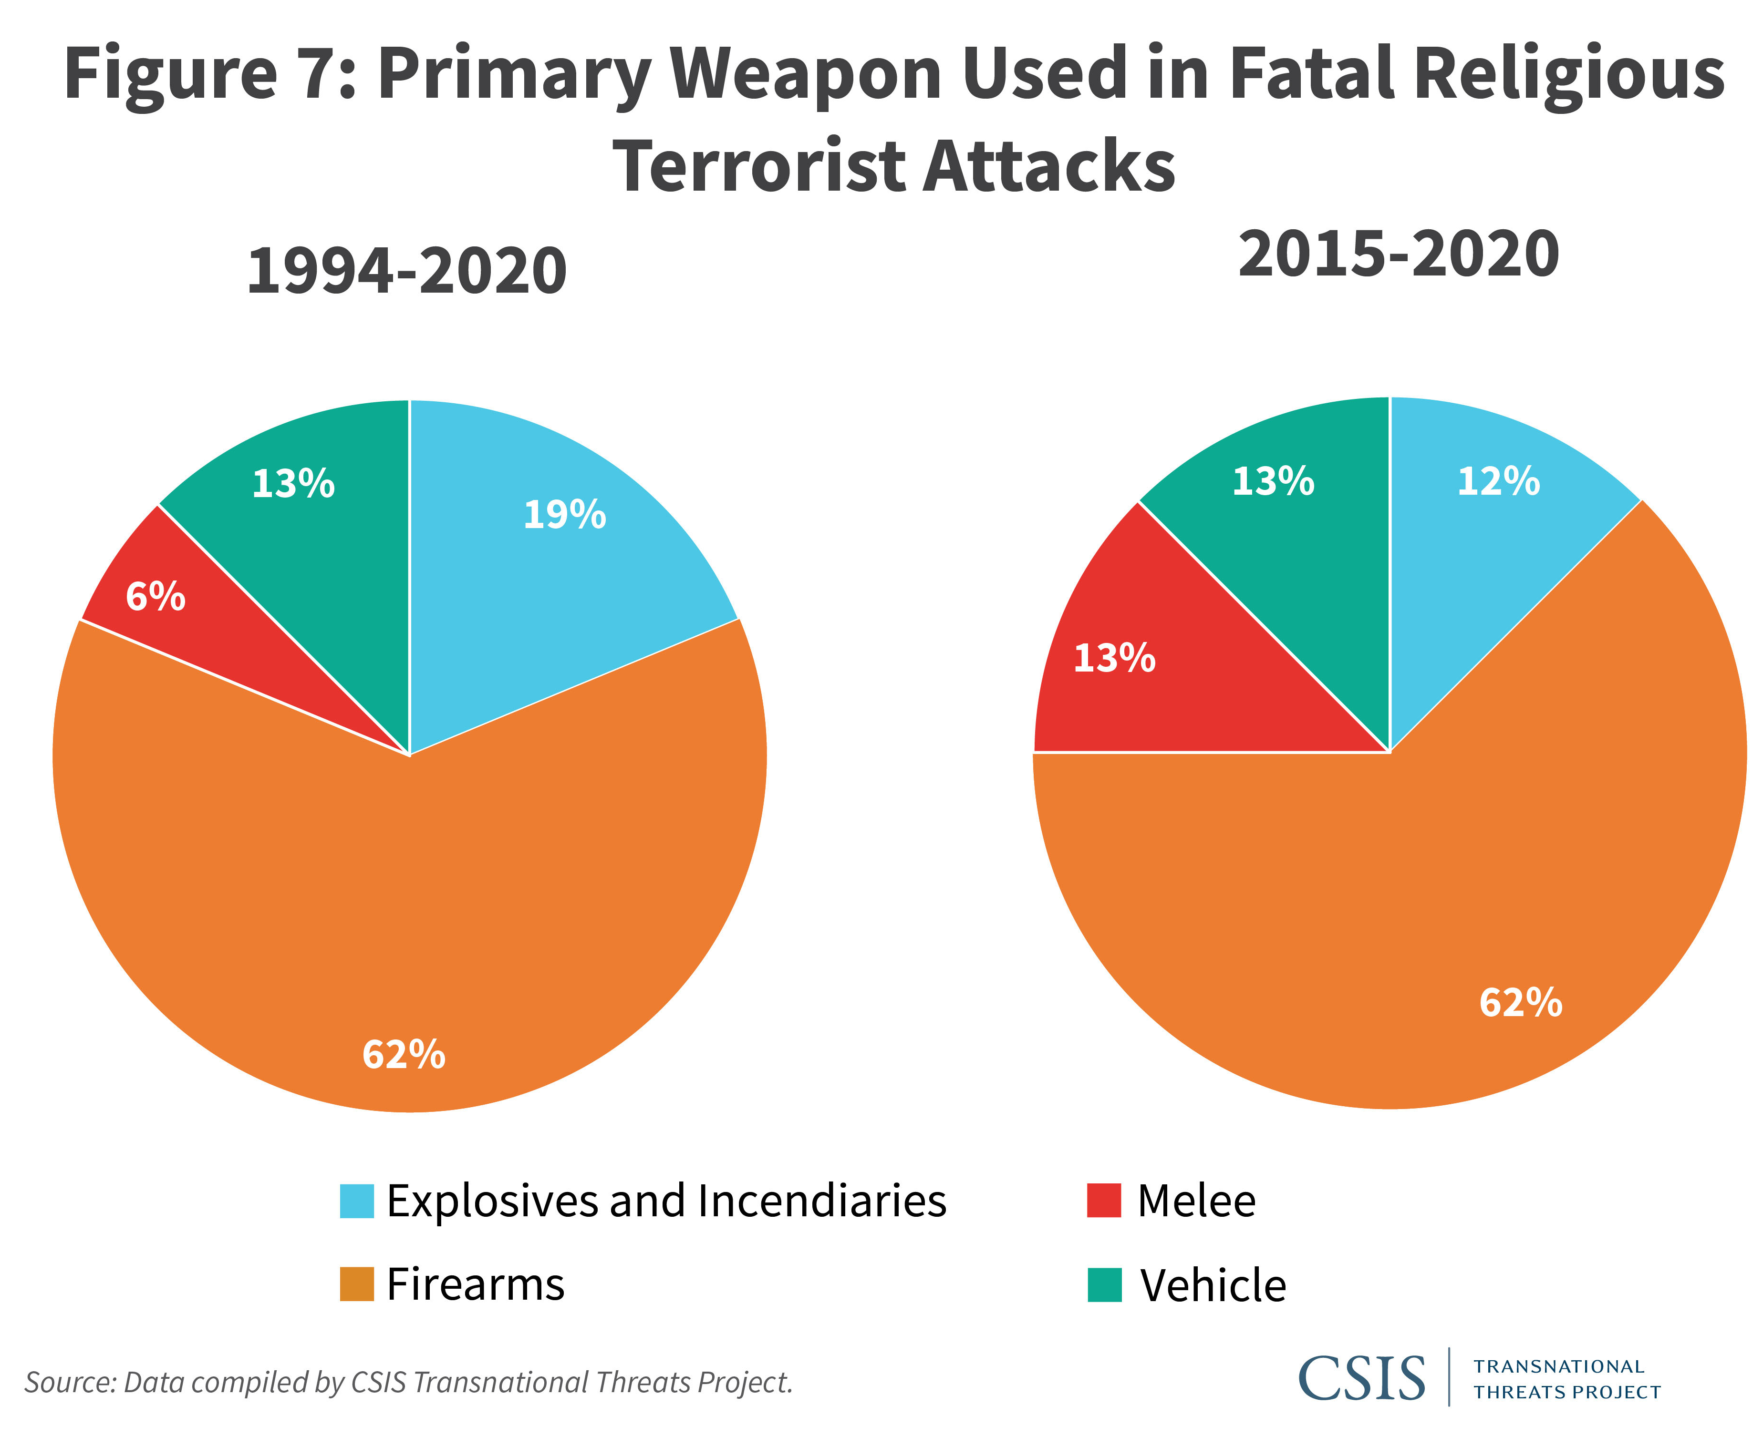

Slide 8
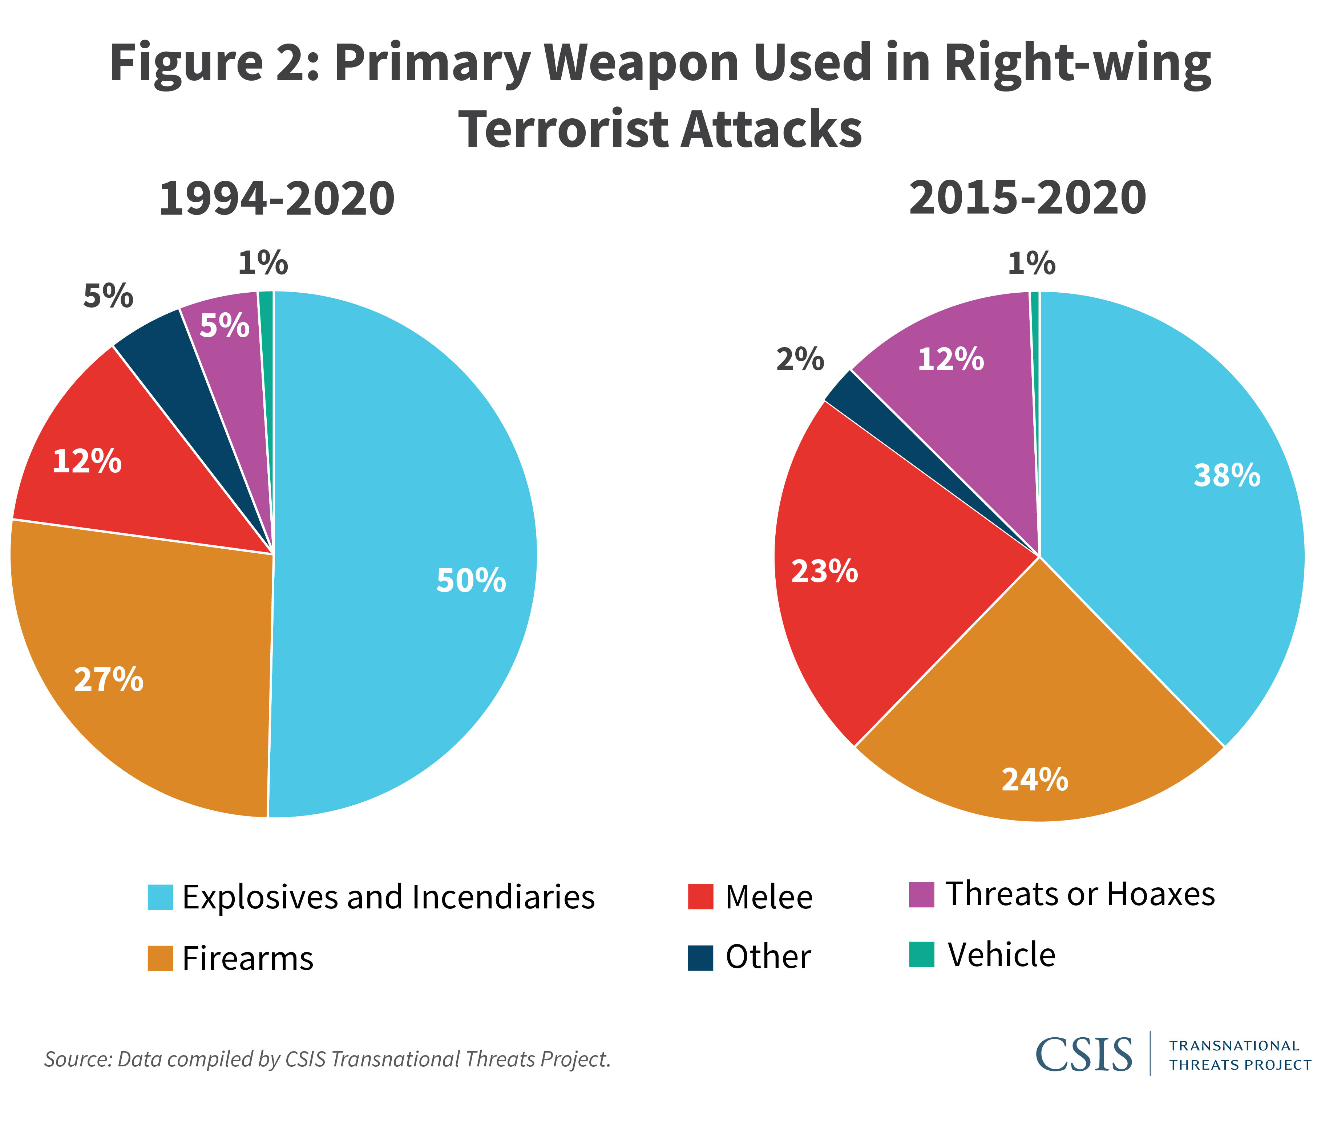
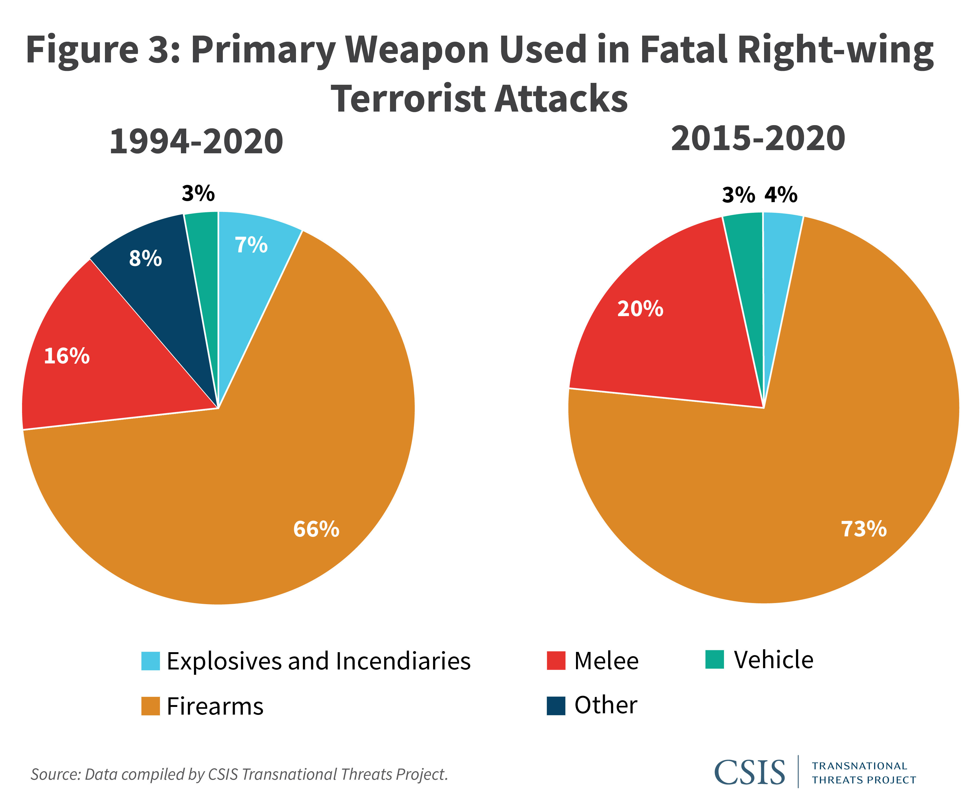

Slide 9
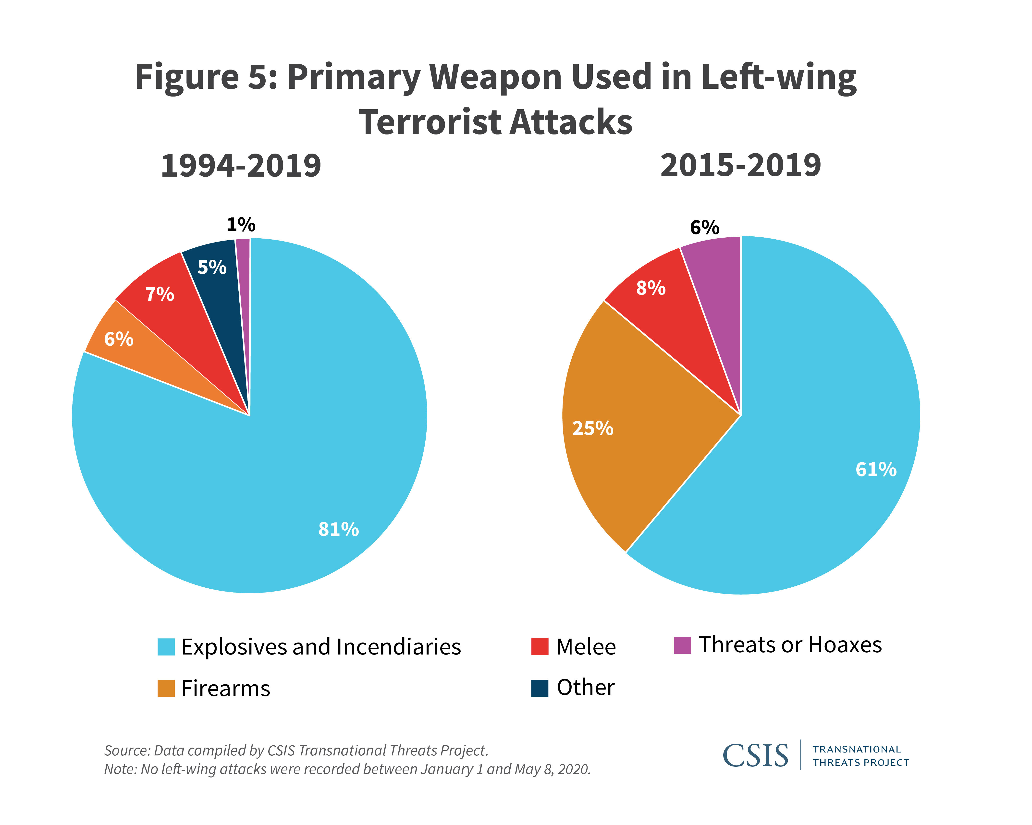

Slide 10
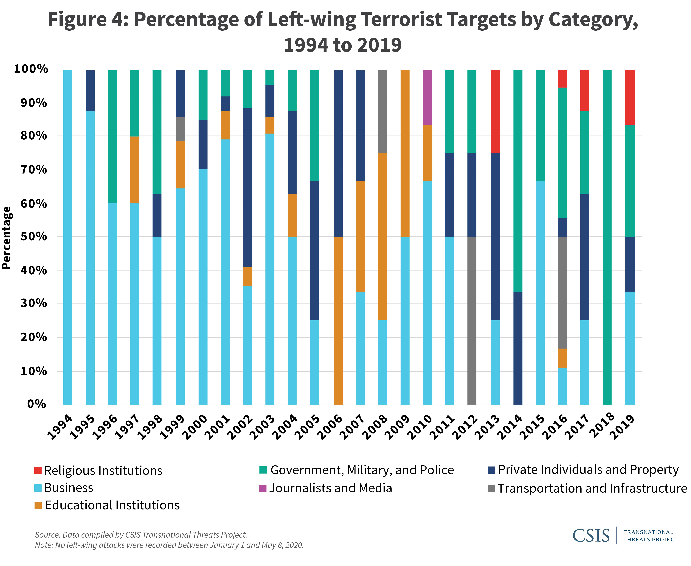
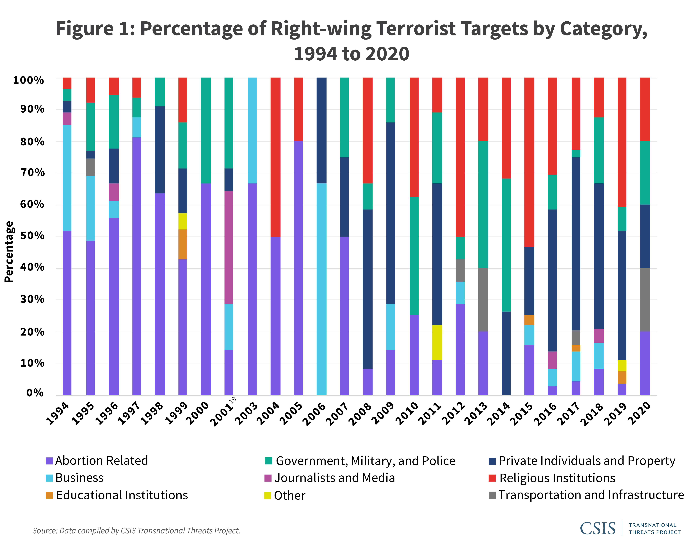
Between 1994 and 2020, the most frequent targets of Salafi-jihadists included: government, military, and police facilities and personnel (41 percent); private individuals or property (22 percent); businesses (12 percent); and transportation and infrastructure (12 percent). The proportion of religious terrorist targets remained fairly consistent between 1994 and 2020.

Slide 11
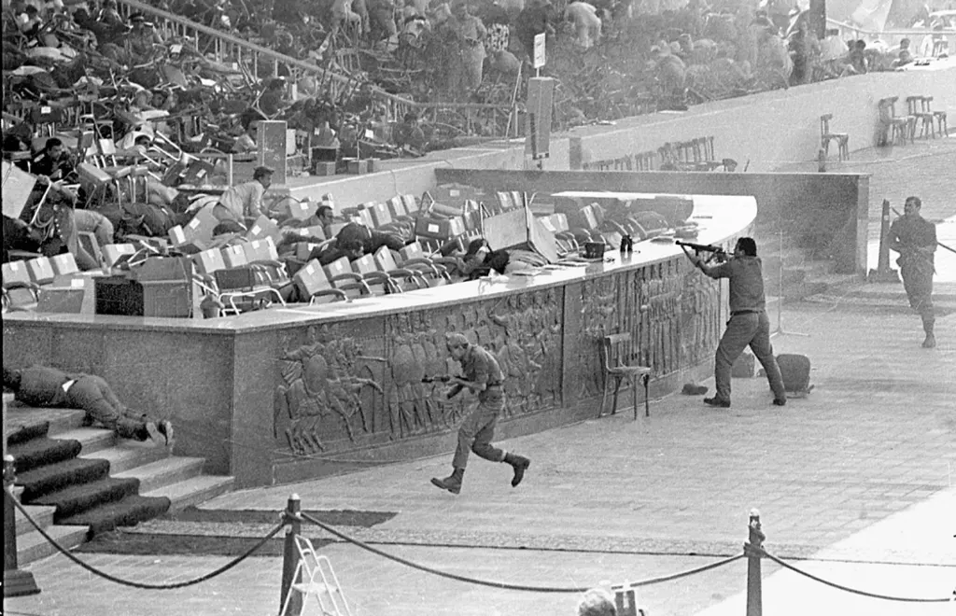
MEDIA AND TERRORISM (then and now)
Access
Cost
Audience
Security
Speed
Multimedia environment
Control
Ability to shape "news"

Slide 12
Radical ISLAMISM AND THE INTERNET
Mid-1990
Email Lists
Early-2000
(forums of limited access (π.χ. Shumukh al-Islam)
mid-2000's
File sharing
Static websites
e.g., Azzam
Web 2.0
Decentralisation
Introduction of social media (particularly youtube)
2010s
Social media
Multilingual and diverse content(e.g., Inspire, Dabiq)

Slide 13
FAR RIGHT AND THE INTERNET
Early-1990
Bulletin board systems
Mid-1990
2000s
Websites
Forum
Static websites (e.g. stormfront)
2010s
Websites (π.χ. Daily Stormer)
Social media (π.χ. Gab, Parler, Telegram, Discord)
Μessage boards (π.χ. 8chan/8kun)
File Sharing
Internet Radio
Online game chats

Slide 14
Al Qaeda has become the first guerrilla movement in history to migrate from physical space to cyberspace
--S. Coll & S. Glasser, Terrorists Turn to the Web as Base of Operations, Washington Post, August 7, 2005

Slide 15
How internet is used?
Propaganda
Radicalization / recruitment
Cyber sanctuary
Creating a virtual community
Communication
Echo chamber
Face-to-face / cyber-radicalization
Jihobbyism (variety of)
  Producers
  Media
  Messages and
  Recipients
Gamification
Live-streaming
Intelligence Collection
Financing
Equipment
Operational Communication
Training
Command & Control
Attacks

Slide 16
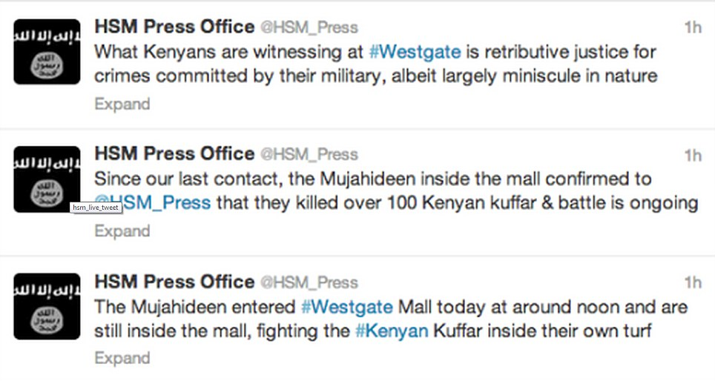
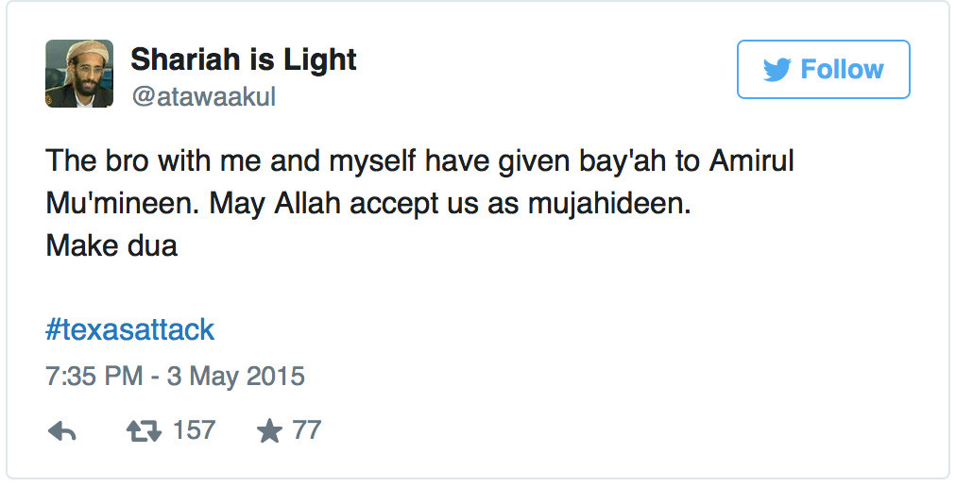
Hayat Tahrir al-Sham
Let’s go for jihad
Mujatweets #2
Health Services in the Islamic State
Larossi Abballa

Slide 17
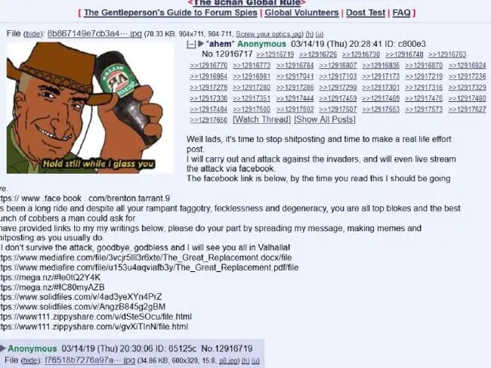

Slide 18
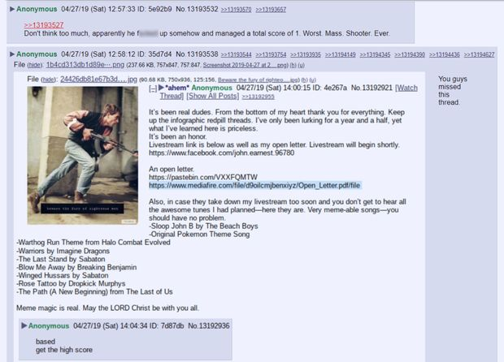

Slide 19
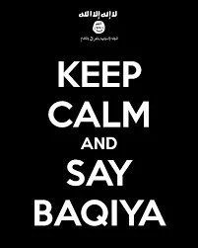
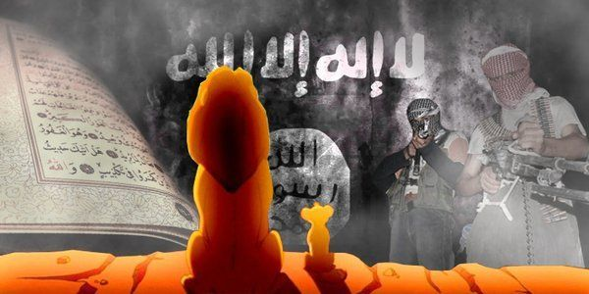

Slide 20
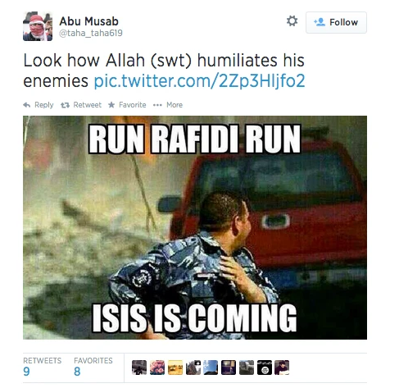
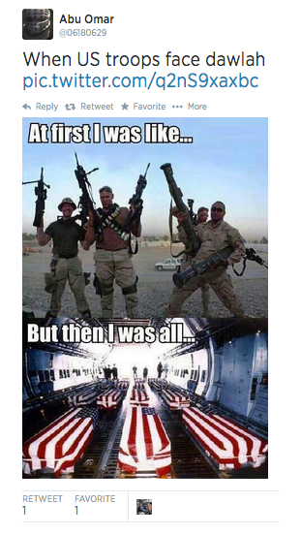

Slide 21
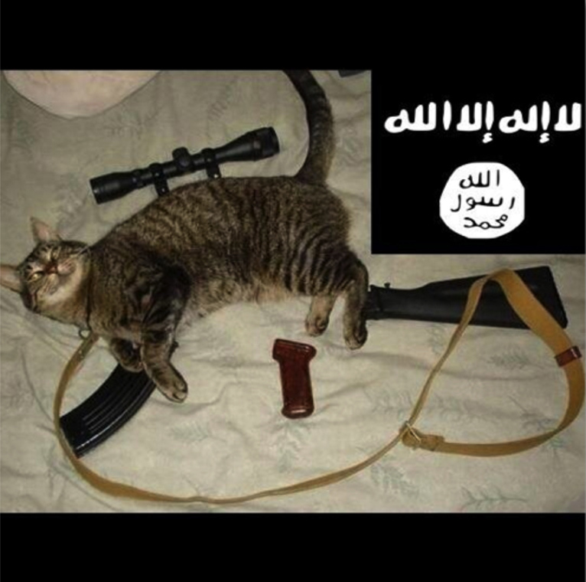
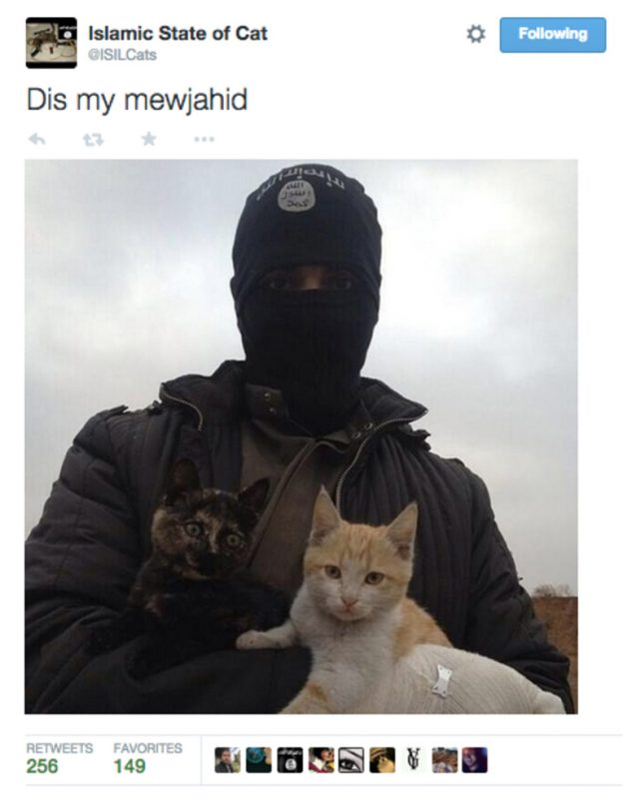

Slide 22
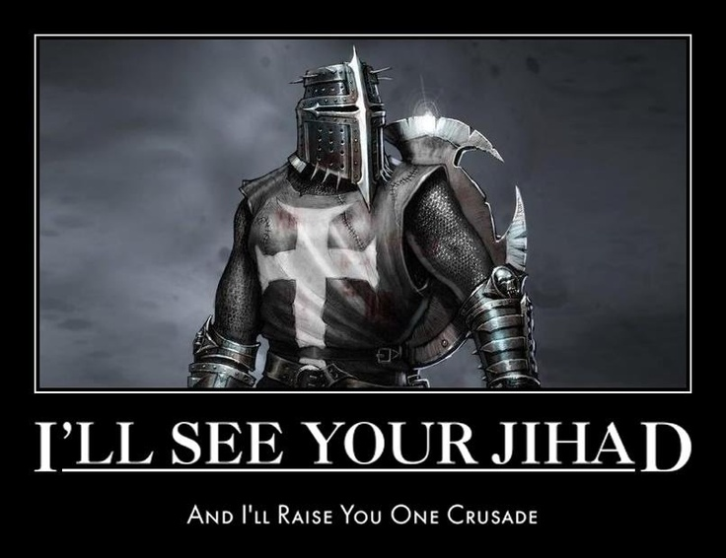

Slide 23
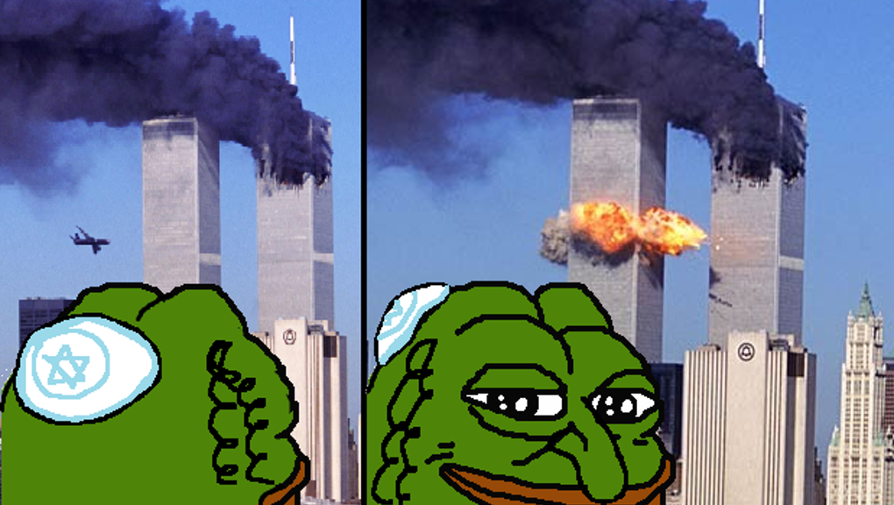

Terms and memes
Symbols of far-right hate speech

Slide 24
