Slide 1

Terrorism: definition, history and root causes
BSc in International Relations & Security
Terrorism, Asymmetric Threats and International Security| 1st Teleconference (1-3)
Marina Eleftheriadou

Slide 2
THE EVOLUTION OF THE CONCEPT OF "SECURITY"
20th century
21st century
Westphalian system
State security
Military (state) threats
Armaments / Alliances
Globalisation
Human security
Multiple (non-state) threats
Securitization / State of emergency
Hybrid war

Slide 3
SECURITY IN THE 21ST CENTURY
Broadening
Terrorism
Deepening
Individual
Particular social groups
Pandemics
Cultural heritage
Environmental security
Energy security
Planet
Migration
Cyber-security

Slide 4
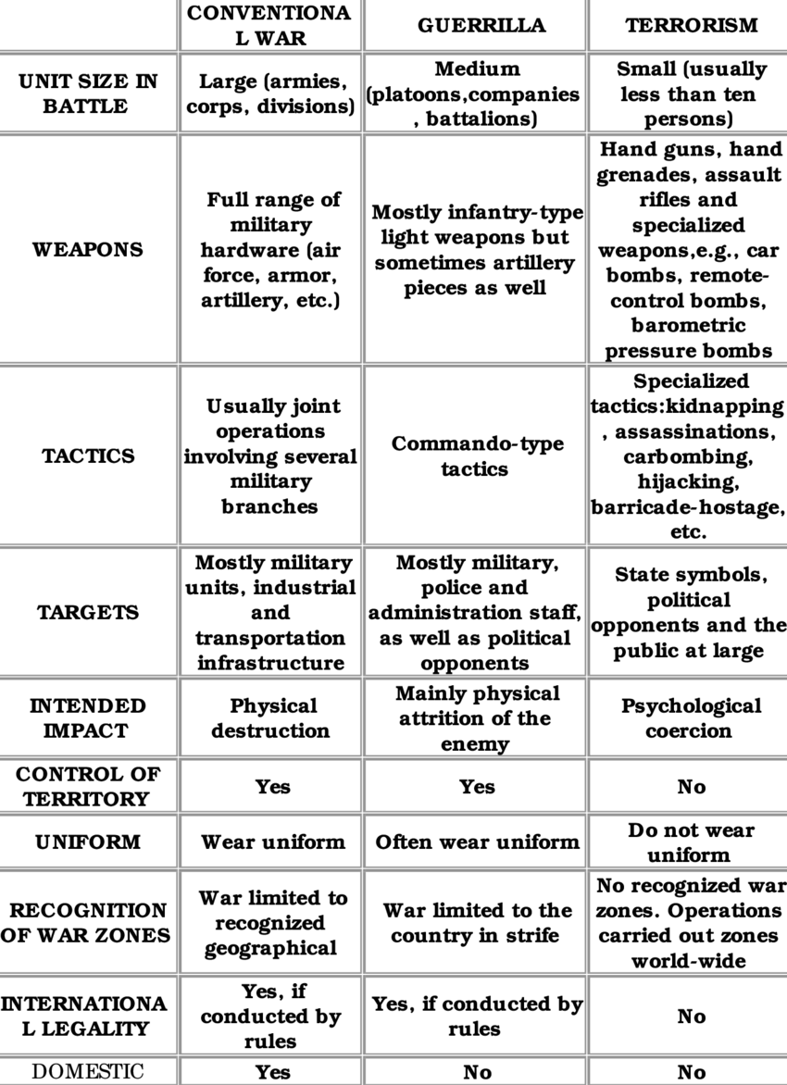
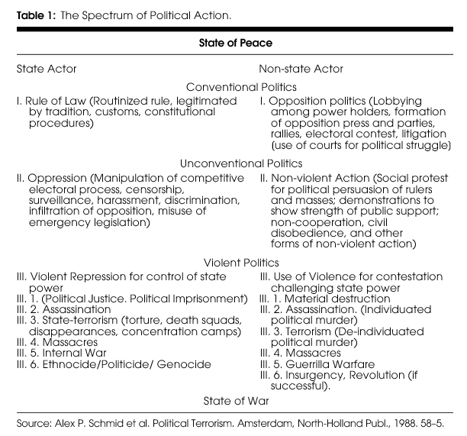
Terrorism and other types of political violence
Merari, A. (1993), Terrorism as a Strategy of Insurgency, Terrorism and Political Violence, Vol.5, No. 4, pp.213-251

Slide 5
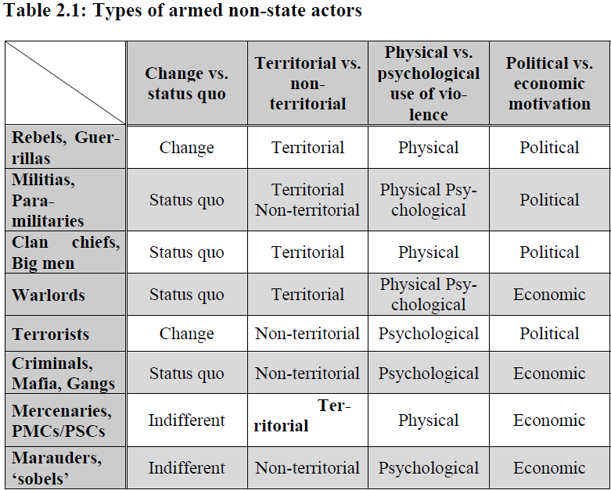
Types of non-state actors

Slide 6
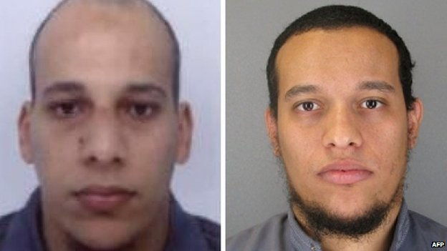
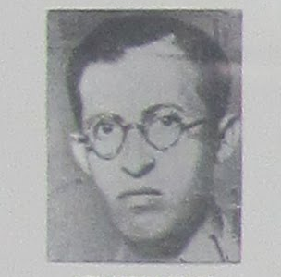
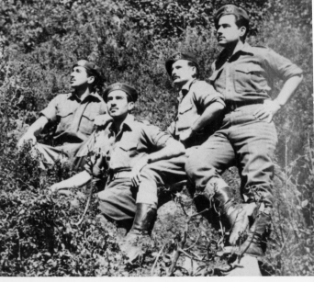
Defining terrorism:
«I know it when I see it»
Key dimensions of the definition:
  Nature of the actor
  Nature of targets/victims
  Means
  Goals

Slide 7
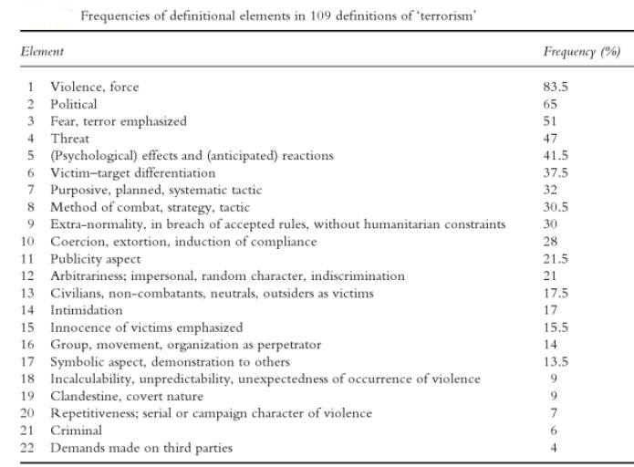
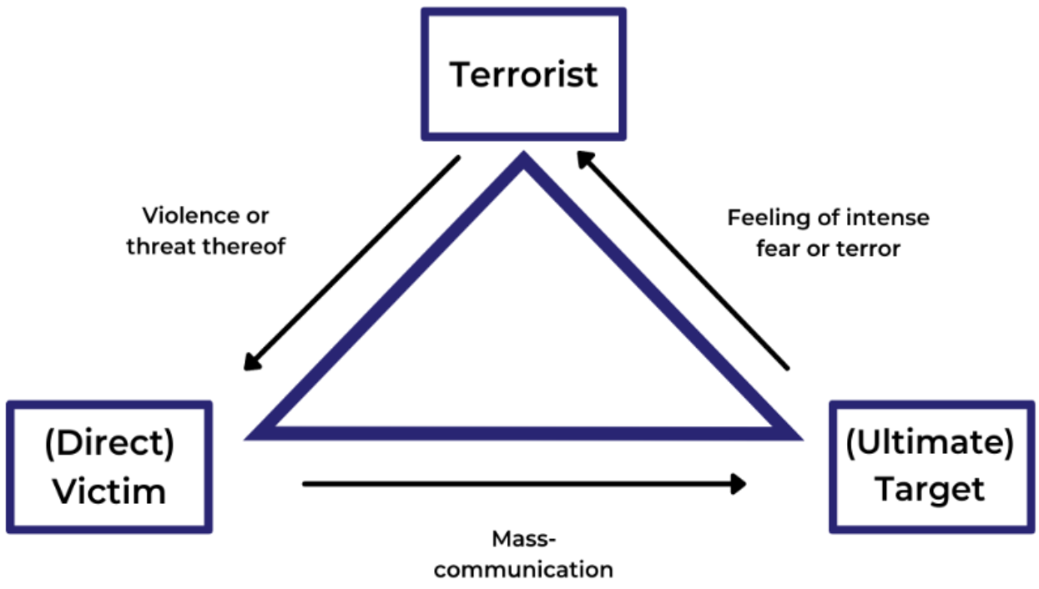
Schmid, A. P. and A. Jongman (1988). Political Terrorism: A New Guide to Actors, Authors, Concepts, Data Bases, Theories, and Literature. London, Transaction Publishers

Slide 8
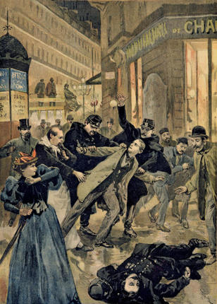
Historical waves of international terrorism according to David Rapoport
Anarchist wave
(1880-1920)
Anti-colonial wave
(1920 [1945] – 1960)
New-left wave
(1960-1980)
Religious wave
(1980- )
Towards a 5th wave?

Slide 9
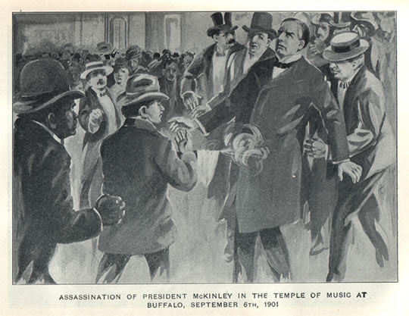
Anarchist wave
Development of transport and communication technologies
Logic of violence: propaganda by deed
Aim: revolutionary change, elimination of all kinds of political and economic injustice
Funding: robberies, donations
Strategy: Assassinations of political and economic elite
Target of attacks: high-ranking officials

Slide 10
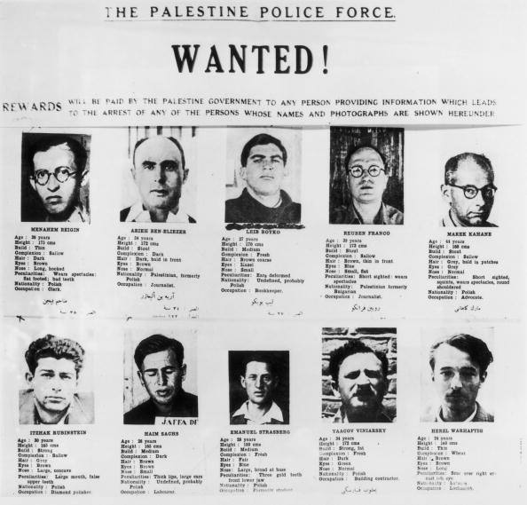
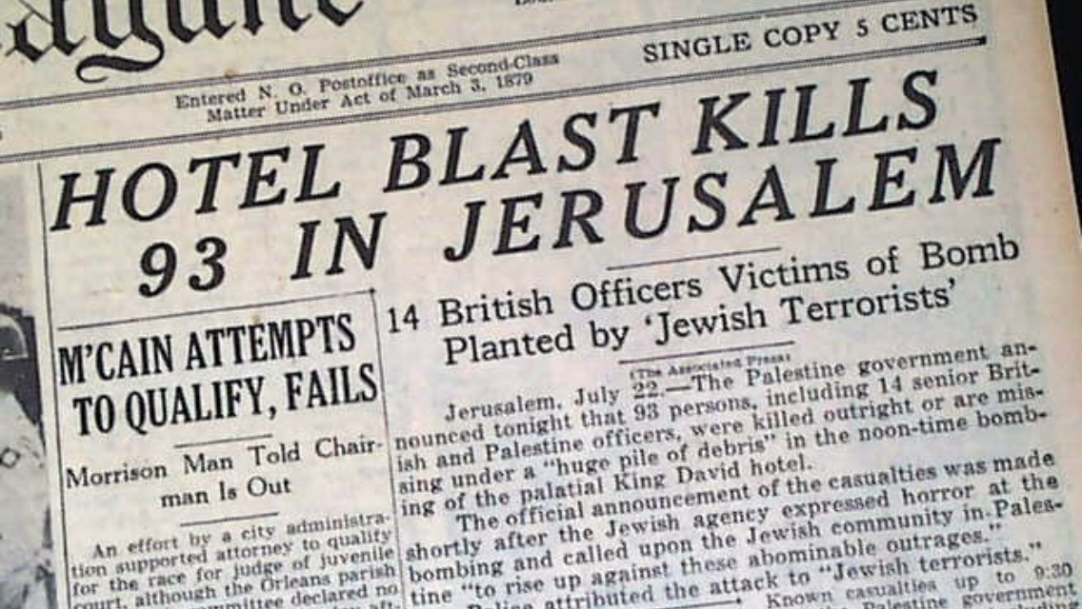
Anti-colonial wave
International shift towards self-determination
Logic of violence: instrumental/military
Strategy: Attacks against police and military targets
Target of attacks: European colonial states
Purpose: expulsion of colonial powers, creation of a state

Slide 11
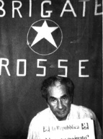
New-left wave
Aim: revolutionary change, support for anti-colonial organizations
Strategy: Symbolic attacks, assassinations, hijackings, kidnappings
Funding: kidnappings, robberies, state sponsorship
Target of attacks: "right-wing" regimes, USA

Slide 12
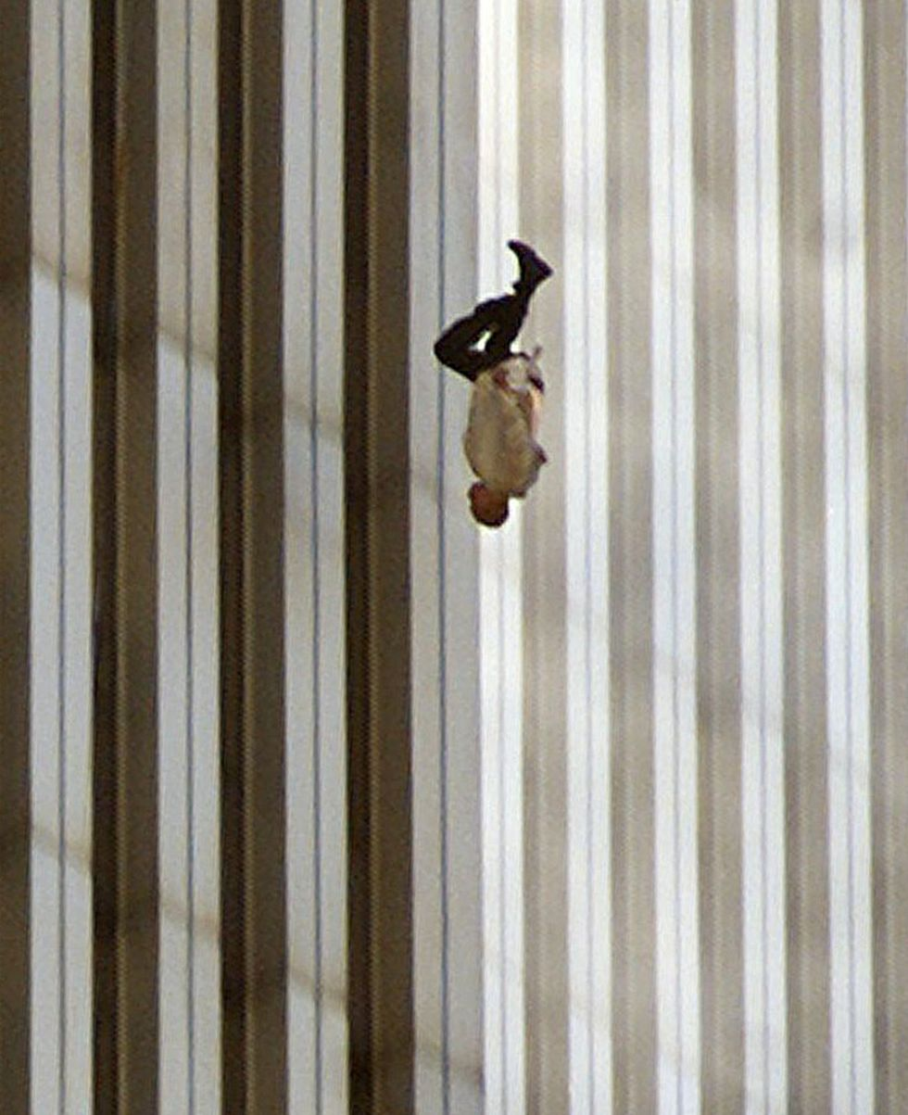
Religious wave
Strategy: suicide attacks, "blind" attacks
Funding: state sponsorship, smuggling, diasporas
Goal: revolutionary change, creation of Islamic State/Caliphate, expulsion of "infidels"

Slide 13
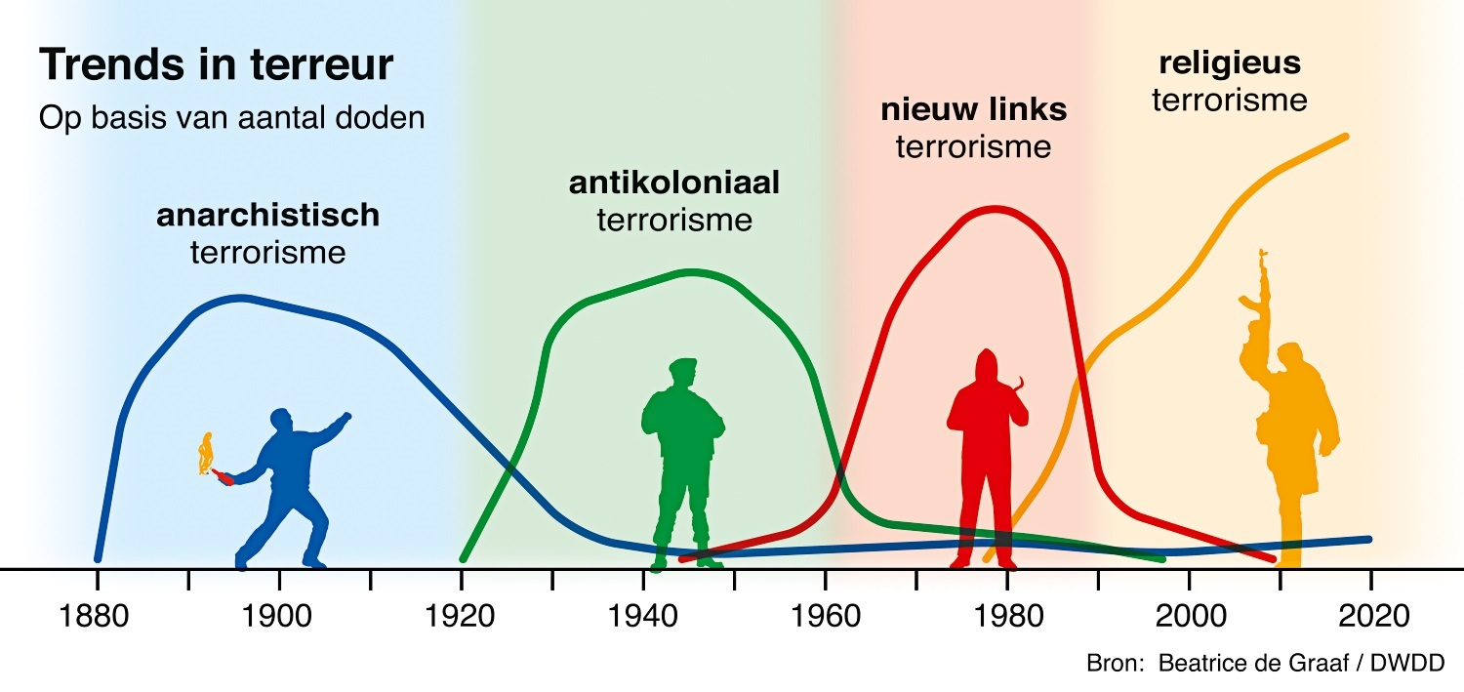
THE END OF THE 4TH WAVE
Wave of "new tribalism"
Technological wave
Continuation/mutation of older waves
Far-right wave

Slide 14
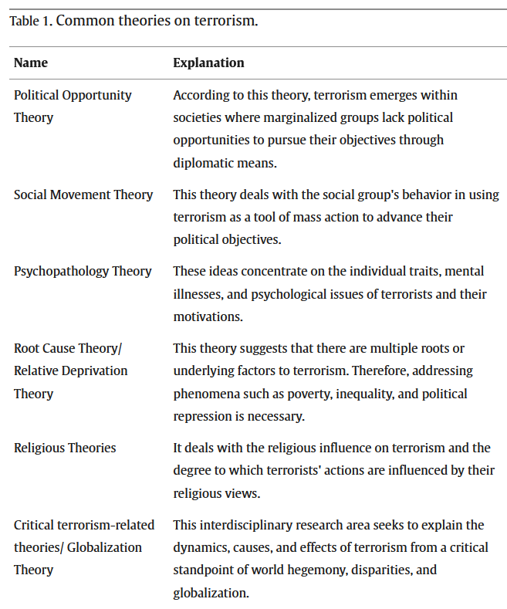
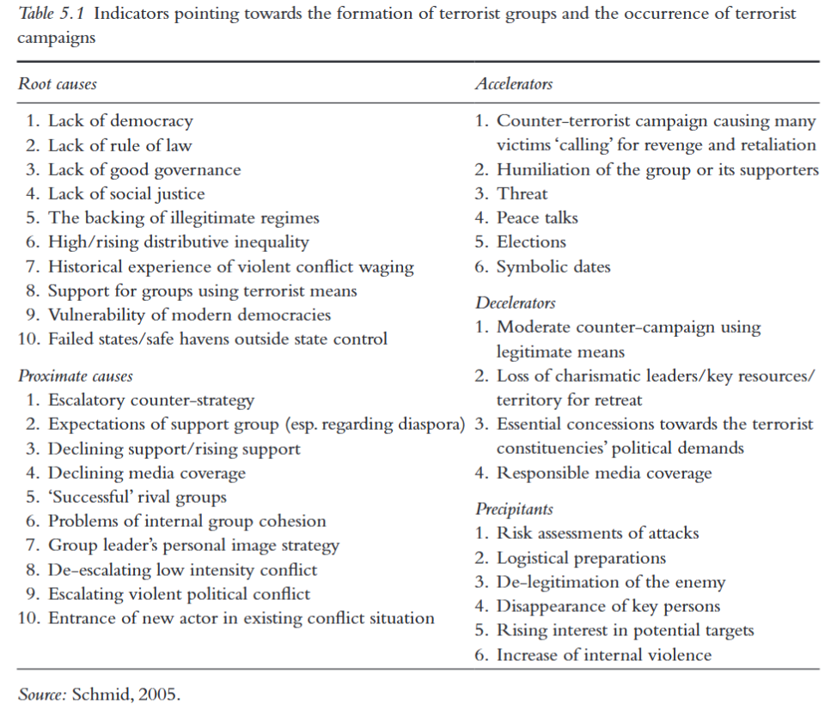
ROOT CAUSES

Slide 15
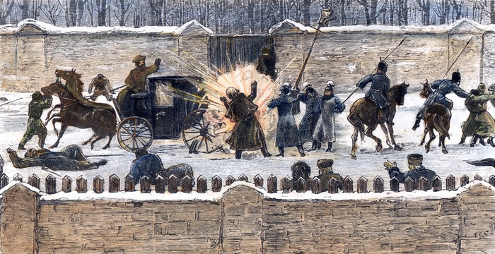
TERRORISM: CAUSES
A. WIDER SOCIO-POLITICAL ENVIRONMENT: "HISTORICAL" CONDITIONS
Modernization
  transport
  communication
  technology
  urbanization
Social enablers
  History of violent activism
  social acceptance of violence
International trends/ideologies
State capacity for repression

Slide 16


TERRORISM: CAUSES
A. WIDER SOCIO-POLITICAL ENVIRONMENT: PRECIPITANTS
Socio-political dynamics
  Feelings of injustice
  Lack of political alternatives
  Elite discontent
Use of disproportionate state force
  Repression of demonstrations
  Mass arrests
  Extrajudicial killings

Slide 17
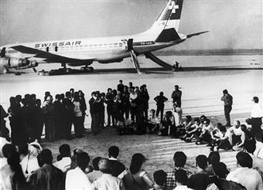
TERRORISM: CAUSES
B. THE GROUP
Strengthening of organization
Weakening of factions or other organizations
Weakness / lack of alternative strategies
Absence of mass support
Impatience
Emerging opportunity
Copycat and contagion

Slide 18
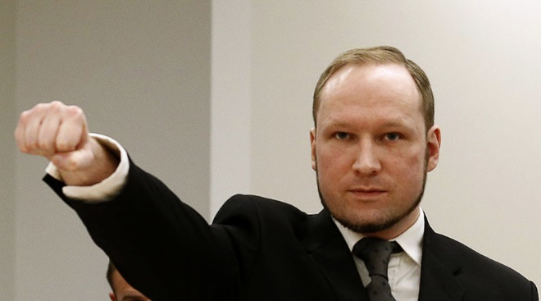
TERRORISM: CAUSES
C. THE INDIVIDUAL
The "personality of the terrorist"
(Personal) Feelings of injustice
Experience and frustration with other forms of struggle
Opportunity
Risk tolerance
Marginalization / Group dynamics
Revenge
The "survivor's guilt"

