Slide 1

Introduction: IR theories, realism and it’s evolution
This presentation is recorded!
Modules 1-3
1st Teleconference meeting
DIRS121: International Relations Theory

Slide 2
IR theories
Theoretical traditions in IR
Realism
International Political Economy
Critical/Alternative approaches
International Society
Liberalism
Constructivism

Slide 3
Fundamental values that states are expected to uphold?
Realism | Security
Liberalism | Freedom
Constructivism | Freedom. Security and interest in cultural identity
International Society | Order and justice
IPE thoeries | Welfare

Slide 4
the great debates
Debate | Time Period | Key Theories | Core Arguments
First Debate: Realism vs. Idealism | 1920s–1930s | Idealism vs. Realism | After WWI, Idealists promoted diplomacy & international law; Realists argued for power politics and state self-interest.
Second Debate: Traditionalism vs. Behavioralism | 1950s-1960s | Traditionalism vs. Behavioralism | Traditionalists used historical & philosophical approaches; Behavioralists advocated for scientific methods and empirical data.
Third Debate: Inter-Paradigm Debate | 1970s–1980s | Realism vs. Liberalism vs. Marxism | The debate expanded beyond realism vs. liberalism, incorporating Marxist critiques of global capitalism and dependency theory.
Fourth Debate: Rationalism vs. Reflectivism | 1980s–1990s | Rationalism vs. Reflectivism | Rationalists (realists/liberals) relied on empirical analysis; Reflectivists (constructivists, post-structuralists) emphasized ideas, identity, and discourse.
Ongoing Debates: Traditional vs. Critical Theories | 2000s–Present | Traditional Theories vs. Critical Theories | Ongoing challenges from feminism, postcolonialism, and global IR perspectives that critique Western-dominated theories.

Slide 5
Main Assumptions of Realism
  Anarchy of the International System/ no authority
  Power struggle
  State-centric
  Self-help
  State are aggressive (human nature)
  National interest defined by power
  Egocentric behavior
  Survival
  Security is the central problem of international politics
  Military power
  Zero sum game

Slide 6
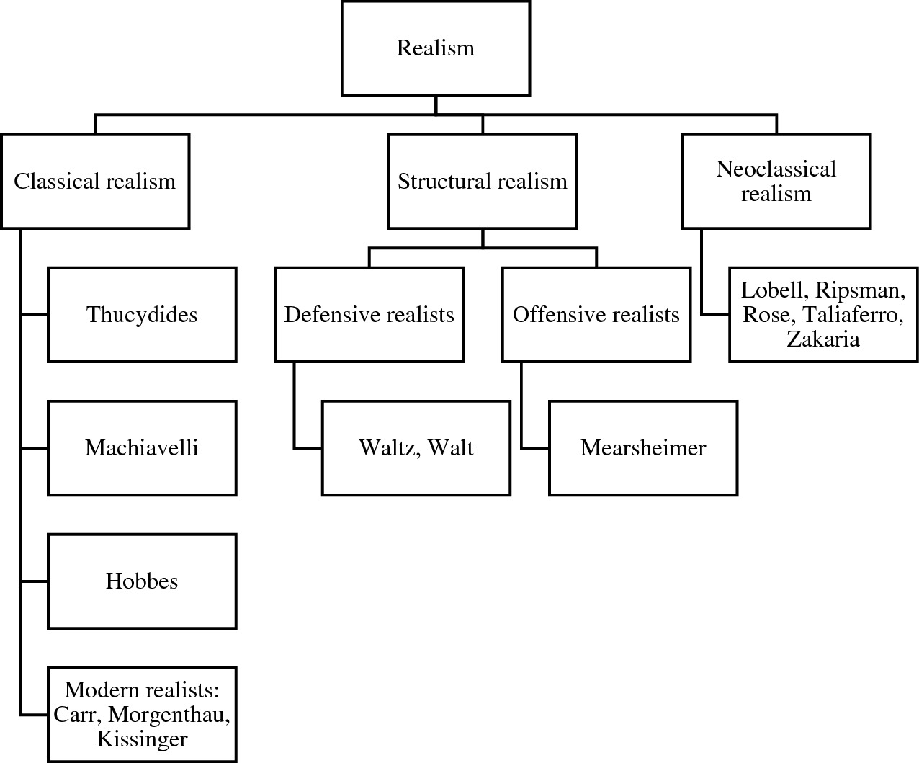

Slide 7
Classical Realism
Politics Among Nations (Morgenthau, 1948): Power is the central force in international relations.
States act based on fear, honor, and interest (Thucydides).
Morality plays a limited role in global politics.
War and conflict are natural outcomes of human ambition.
📌 Key Thinkers: Thucydides, Niccolò Machiavelli, Hans Morgenthau
📌 Core Ideas: Human nature is inherently selfish and power-seeking.
📊 Quote: "The struggle for power is universal in time and space." – Morgenthau
🎯 Criticism: Overemphasizes human nature, ignores institutions and economic factors.

Slide 8
Neorealism (Structural Realism)
International anarchy (lack of central authority) shapes state behavior.
Defensive Realism (Waltz): States seek survival, not unlimited power.
Offensive Realism (Mearsheimer): States seek dominance to ensure security.
The structure of the international system (unipolar, bipolar, multipolar) determines outcomes, not human nature.
📌 Key Thinkers: Kenneth Waltz, John Mearsheimer
📊 Example: Cold War – Bipolarity between the U.S. and USSR maintained stability.
🎯 Criticism: Ignores domestic politics, ideology, and leadership.

Slide 9
Balance of threat theory (Walt 1987)
While neorealism (structural realism) explains alliances based on power dynamics, Walt refines this by arguing that states form alliances based on perceived threats, not just power.
States seek alliances to maintain the balance of power in an anarchic international system.
Bipolarity is more stable (e.g., Cold War alliances: NATO vs. Warsaw Pact).
Multipolarity increases uncertainty and alliance shifts.
Core Argument:
States do not balance against power alone but against threats.
Threat perception is shaped by:
Aggregate Power – A strong state is more threatening.
Geographic Proximity – Closer threats are more dangerous.
Offensive Capability – States with aggressive military power are seen as bigger threats.
Perceived Intentions – A state's history and ideology affect how threatening it appears.
📊 Example: NATO vs. USSR (Cold War) – The U.S. allied with Western Europe not just because of Soviet power, but because of Soviet expansionism (perceived intentions).

Slide 10
John Mearsheimer’s Offensive Realism
Contrary to Waltz’s Defensive Realism (1979) that states seek security, not domination.
Balancing power (alliances, military buildup) ensures survival.
Excessive expansionism is counterproductive.
📌 Key Assumptions of Offensive Realism:
Anarchy Rules – No world government to enforce peace.
States Fear Each Other – No trust in international relations.
Survival is the Priority – The strongest state survives.
Power is the Key – States seek to become regional hegemons.
War is Inevitable – Conflict arises as states compete for dominance.
📌 Core Argument of Offensive Realism:
States are power-maximizing actors, always seeking to dominate the system.
Best way to ensure security? Become the hegemon.
The international system forces states to act aggressively to avoid being dominated.

Slide 11
John Mearsheimer’s Offensive Realism
📊 Example: U.S. and China Rivalry
The U.S. dominates as a regional hegemon in the Western Hemisphere.
China’s rise is a direct challenge—leading to U.S. efforts to contain it (e.g., alliances with Japan, India, Australia).
According to Mearsheimer, this makes U.S.-China conflict highly probable.
Offensive Realism explains why great powers always seek more power and why major conflicts occur.

Slide 12
Neoclassical realism
📌 Key Thinkers: Gideon Rose, Randall Schweller, Fareed Zakaria
📌 Core Ideas: Blends Classical Realism & Neorealism
Structure matters, but domestic factors influence how states react.
Leaders' perceptions and domestic politics affect foreign policy choices.
Key Variables: State strength, national interests, elite ideology.
Example: U.S. invasion of Iraq (2003) – Structural factors (power politics) + domestic influences (neoconservatism, public opinion).
Criticism: Hard to measure how much domestic vs. international factors matter.

Slide 13
Graham Allison and the Thucydides Trap
The Thucydides Trap - explains the risk of war when a rising power threatens to displace an established power. The idea originates from the Peloponnesian War (431–404 BCE), where the rising power Athens challenged the dominant Sparta, leading to inevitable conflict.
The Core Argument
📌 Graham Allison’s Key Idea (Destined for War, 2017):
When a rising power (e.g., China) challenges a ruling power (e.g., the U.S.), war is likely.
Historical analysis of 16 cases over 500 years: 12 resulted in war, while only 4 ended peacefully.
📌 Why Conflict Happens?
Fear & Insecurity – The dominant power fears losing its position.
Power Transition – The rising power seeks more influence.
Miscalculation – Leaders underestimate the risk of escalation.

Slide 14
Historical Examples of the Thucydides Trap
📊 Wars that Confirm the Trap:
✔ Peloponnesian War –. Sparta vs Athens (5th century BCE)
✔ WWI – Germany (rising) vs. Britain (established)
✔ Napoleonic Wars – France (rising) vs. Britain (established)

Slide 15
U.S.-China Rivalry: The Modern Thucydides Trap?
📌 China’s Rise
Rapid military and economic growth.
Expanding influence in Asia (Belt and Road Initiative, South China Sea).
📌 U.S. Response
Military alliances (QUAD, AUKUS, Indo-Pacific strategy).
Trade restrictions (tech bans, tariffs).
📌 Risk of War?
Taiwan crisis, South China Sea disputes, trade war tensions increase chances of conflict.
Allison warns that miscalculations (as seen in WWI) could lead to war.

Slide 16
Conclusion: Lessons from Allison’s Thucydides Trap
History suggests rising vs. ruling power conflicts are dangerous.
Diplomacy, economic U.S. and China must manage tensions carefully to avoid war.
cooperation, and military restraint are key to breaking the cycle.
Criticism of the Thucydides Trap
❌ Overgeneralization – Not all power transitions lead to war.
❌ Ignores economic interdependence – U.S. and China have deep economic ties.
❌ Agency Matters – Diplomatic solutions, not just power dynamics, shape outcomes.

